Slide 1
Infection Prevention and Control Training for Early Years and other Educational Settings (EYES)
Notes:
Presenter notes:
Welcome to our Infection prevention and control training for Early Years and other educational settings

Slide 2
Aims of Training
To equip teachers and those who work in Early Years settings with;
knowledge of what infections are, how they are caused, and transmitted
knowledge of ways to prevent the spread of infection in their settings.
how staff can protect themselves during an outbreak
how to manage infectious disease outbreaks in their settings
what to do if they suspect an infectious disease outbreak in their setting
where/who to go to for support when there has been an outbreak in your setting
when and how to contact the Health Protection Teams for support during outbreaks

Slide 3
Completing the Training
This training should take 1 hour to complete
This can be completed at your own pace. You do not have to complete it in one session, you can come back and complete short sections at a time.
You can use the slide deck and read the narrative to compliment what is on each slide
Alternatively, there is an option to use the video which will talk you through each slide.

Slide 4
Section 1 Awareness and Management of IPC and Hygiene Practices
Notes:
Presenter Notes
The presentation is divided into 3 sections so lets jump right in with section 1 : Awareness and Management of IPC and Hygiene Practices in EYES to prevent children missing education

Slide 5
Infections in EYES
Infections are common and for most people the risk of severe disease is low
Infections can be picked up anywhere
Infections are caused by microbes (or germs) such as bacteria, viruses, fungi, and parasites
Microbes are everywhere and most do not cause infection and can even be beneficial
However, some microbes can cause infections when they get into the wrong place, which can result in symptoms such as fever and sickness.
Disease causing microbes are known as pathogens
Notes:
Presenter notes:
Infections are really common, and for most people the risk of complications or severe disease really quite low.
Infections can be picked up anywhere, at home or in the wider community so are often brought into EYES or picked up and spread within the EYES setting itself
Infections are caused by microbes (or germs) such as bacteria, viruses, fungi, and parasites
Microbes are everywhere, the live on our skin and in the environment and most do not cause infection and can even be beneficial . Bacteria on our skin, in our airways, and in our digestive system are the first line of defence against microbes that can cause infection.
However, some microbes/germs can cause infections when they get into the wrong place, which can result in symptoms such as fever and sickness.
Disease causing microbes are known as pathogens

Slide 6
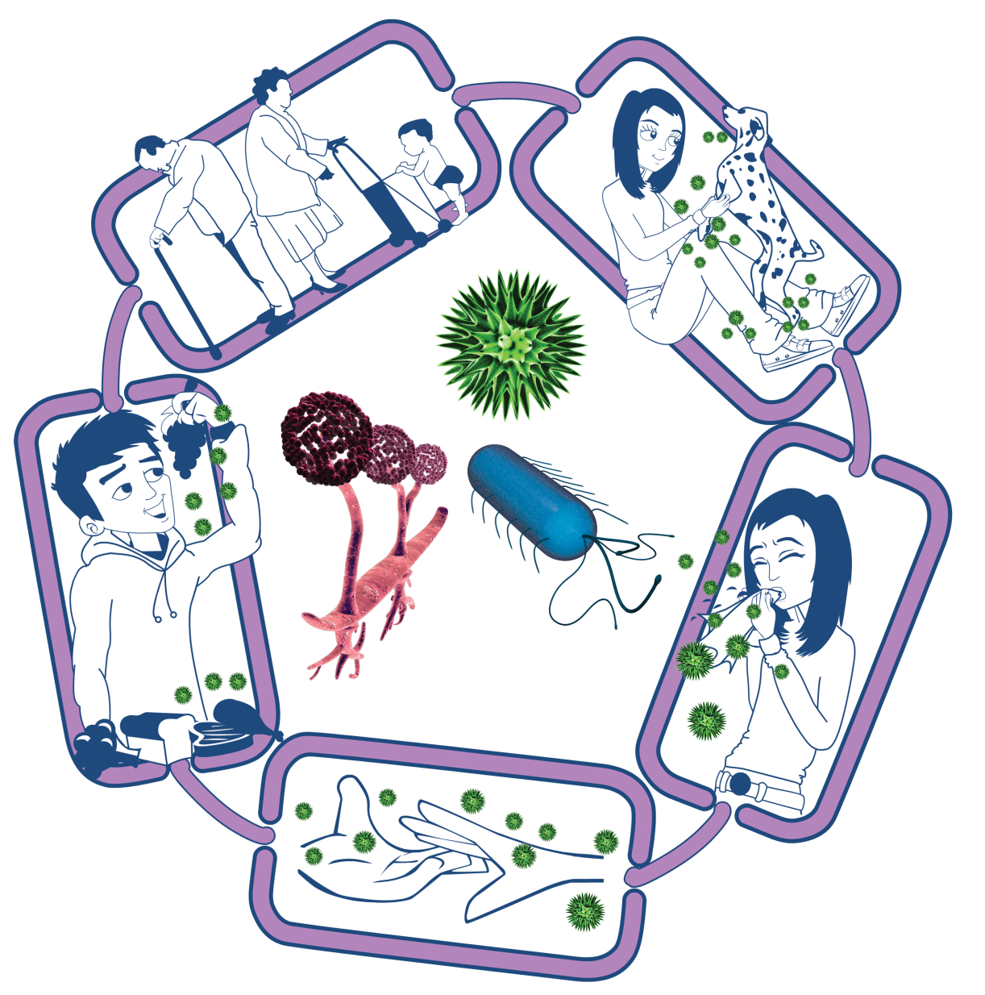
How infections spread- The Chain of Infection
People at risk from
infection
We are all at risk from
infection, but some are at greater risk:
• People on medication
e.g chemotherapy
• The very young/elderly
• People with underlying diseases e.g HIV/AIDS, diabetes
Source of infection
Someone or something carrying the harmful microbes that causes the infection. There are many different sources of infection, these can include:
• People already infected
• Pets or animals
• Contaminated food
Way out for microbes
Harmful microbes need a way to get out of an infected person or source before they can spread to someone else. Routes include:
• Sneezing, coughing, saliva
• Bodily fluid
• Juices from raw meat and poultry
Way in for microbes
Harmful microbes need a
way to enter the body before they can cause an infection. This can be
through:
• The food we eat
• Inhalation of aerosols
or droplets
• Open cuts or sores
• Things we put in our
mouths
Spread of infection
Harmful microbes need a way to be passed from a source to a person. This can be through:
• Direct touch/contact
• Sexual transmission
Harmful microbes are also spread via:
• Hands, hand contact surfaces (e.g. door handles, keyboards, toilets)
• Food contact surfaces
• Air
Notes:
Presenter notes:
The chain of infection helps us to understand how infections spread. Each chain in the infection has to come together for an infection to occur; by understanding this chain, we can then look for opportunities to break the chain, which in turn can help prevent infections from spreading to others. The chain of infection can be broken at any link, and the more links that can be broken, then less chance there is of an infection happening.
There are 5 links to this chain of infection and we will discuss each one in turn.
The source of infection is where the harmful microbe is, this can be people who are already infected (and we don’t always know if someone is infected), pets and animals and also contaminated food or contaminated surfaces.
The second link is way out for microbes: this means that the harmful microbe has to have a way of getting out of an infected person or other source before it can spreads to someone else. Ways this can happen is by sneezing, coughing, bodily fluids, or juices from raw meat and poultry.
The 3rd link is spread of infection. This is the easiest link to break. There are many key hygiene measures that we can do to ensure infections do not spread to others, which we will explain later on. There are many ways that harmful microbes can spread, direct contact, through the air and through indirect contact with surfaces or the environment.
The 4th link is way in for microbes, so just like the way out link, harmful microbes need a way of getting into a person’s body, which can be through the food we eat, inhaling infections that spread though the air, through open cuts and sores and through things that we put in our mouths (usually via our hands).
The last link in the chain is people at risks of infection. This is probably the one link that we have little control over. Everyone is at risk of infection but there will be some people who are at higher risk than others, such as people who are taking medications for example chemotherapy which weakens their immune system. , the very young and the elderly and people who have underlying health conditions. We see many grandparents now taking on the role of helping with child care, who may have underlying health conditions, therefore it is even more important that we consider this population when considering risks in EYES.
Now we understand the chain of infection, we can go into more details on the common modes of infection transmission

Slide 7
Common Modes of Transmission for EYES
Direct Contact
From the infected area/person to another person’s body
Through the air (aerosol)
Faecal-oral
Gastro-intestinal infections can spread from person to person
Usually via hands or via contact with a contaminated surface.
This is the most common way an infection can spread
Examples include scabies, headlice, ringworm and impetigo.
Aerosols can contaminate hands, cups, toys, or other items and spread to those who may use or touch them.
Examples include common cold, COVID-19, influenza, and whooping cough.
From the infected person to another person
Can spread without necessarily having close contact
Examples include norovirus and E.coli
When infected faeces (poo) or vomit are transferred to the mouth either directly or from contaminated food, water, or objects such as toys, door handles or toilet flush handles.
Usually via sneezing, coughing, singing, and talking
Notes:
Presenter notes:
The 3 main transmission routs that are seen in EYES include direct contact, through the air and faecal oral transmission.
Direct contact is the most common way infections can spread from one person to another, usually by hands touching an infected person or a contaminated surface. Examples of infections of the skin, mouth and eye that are spread in this way are scabies, headlice, ringworm and impetigo.
Through the air is a new terminology (it used to be called airborne or respiratory droplets, this is no longer used as the distinction between the two are not clearly distinguishable, so are now under the umbrella of through the air). Infection that spread through the air spread easily between people. Sneezing, coughing, singing, and talking may spread from an infected person to someone close by
Infections that spread through the air can also spread without necessarily having close contact with another person. When infected, a person's mouth or nose may also contaminate hands, cups, toys, or other items and spread to those who may use or touch them, particularly if they then touch their nose or mouth.
Examples of infections that are spread in this way are the common cold, COVID-19, influenza, and whooping cough
And lastly Faecal-oral mode of transmission. This is when gastro-intestinal infections spread from person to person when infected faeces or vomit are transferred to the mouth either directly from hands or from contaminated food, water, or objects such as toys, door handles or toilet flush handles. Examples of infections spread in this way include hepatitis A, Shiga Toxin-producing Escherichia Coli (STEC), and norovirus

Slide 8
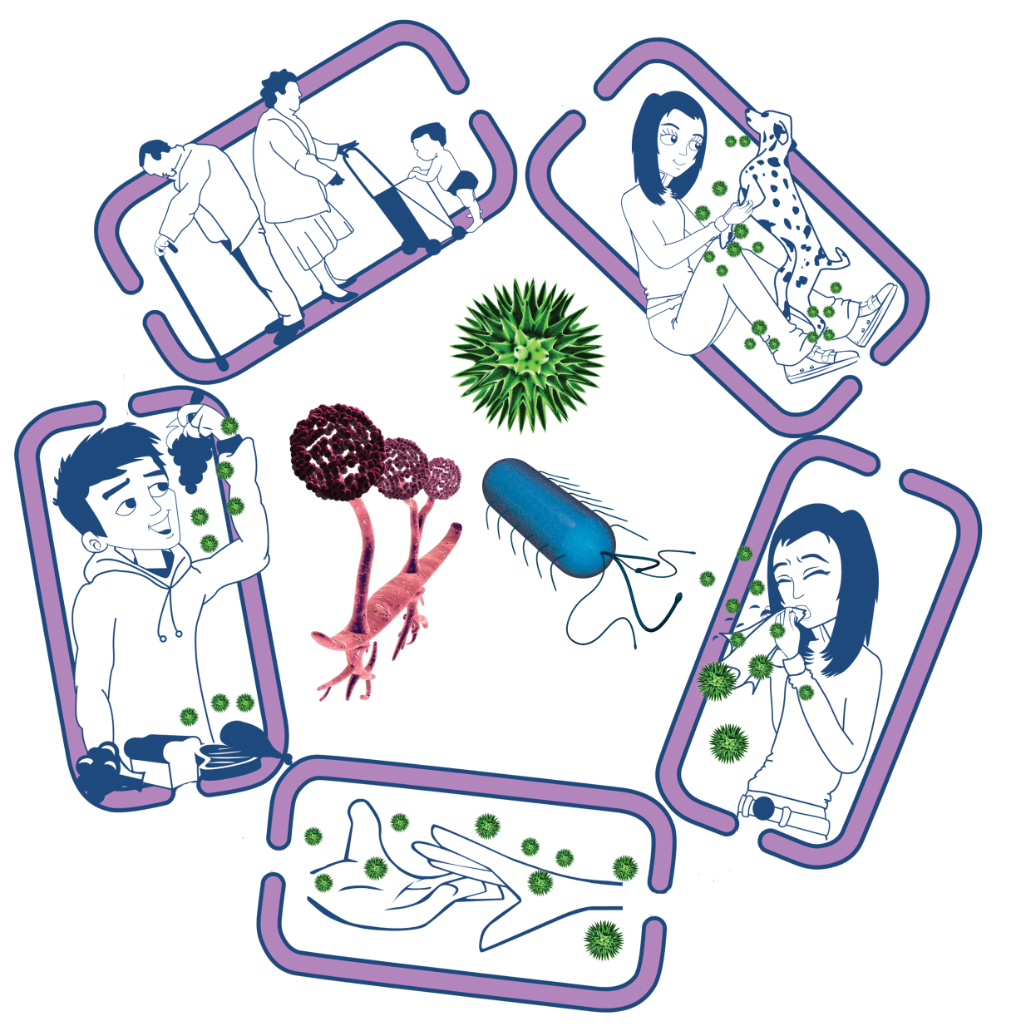
Breaking the Chain of Infection
People at risk from
infection
Everyone:
• Take appropriate vaccinations
High risk people:
• Keep away from people who are infectious
• Take extra care about cleanliness
• Take extra care when cooking and preparing food
Source of infection
• Isolate infected people
• Take care with raw food
• Wash pets regularly
• Treat pets for pathogens when needed
• Dispose of nappies and soiled clothing appropriately
Way out for microbes
Prevent any:
• Coughs and sneezes
• Faeces
• Vomit
• Bodily fluid
Getting onto surfaces or hands
Way in for microbes
• Cover cuts and open sores with a waterproof dressing
• Cook food properly
• Take care to drink only clean water
Spread of infection
• Wash hands thoroughly and regularly
• Cover cuts and open sores
• Take appropriate precautions during sexual activity

Slide 9

Five key hygiene and prevention measures
Ventilation
Wash your hands!
Catch your coughs!
3
Environmental cleaning
2
4
Vaccination
5
Stay at home if unwell
1
These measures are very effective in preventing the spread of infections
Chapter 2: infection prevention and control - GOV.UK (www.gov.uk)
Notes:
Presenters notes
We are now going to go through key hygiene and prevention measures that can help us to break the chain of infection.
We have placed these into 5 categories which we will discuss through the next few slides. These categories are:
Stay at home if you are unwell
Wash hands and catch coughs
Ventilation
Environmental cleaning
And vaccination

Slide 10
Staying at home if unwell
1
Children who are unwell should not attend the setting and should remain at home until their acute symptoms resolve. This has always been the case.
Public health exclusions refers to the time period an individual should not attend a setting to reduce the risk of transmission during the infectious stage. This is different to ‘exclusion’ as used in an educational sense.
Different infections can have different exclusion periods or none at all - for more information visit Chapter 3: public health management of specific infectious diseases - GOV.UK (www.gov.uk)
Examples of acute symptoms with which children should not attend school/nursery include fever, muscle aches, hacking cough, D&V or specific diagnoses (e.g. chickenpox) that carry an exclusion. Examples of symptoms with which children could attend school/ nursery include persistent runny nose, irritable cough
Notes:
Presenter note:
Staying at home if unwell is really important, because it stops infections from spreading to others. We appreciate that its very inconvenient for parent to keep children away from EYES as it impacts their work, but it is really important that clear polices are in place, so it is clear on expectations around keeping children off from EYES if they are unwell.
It is important that exclusion periods are kept to, and these will differ depending on the microbe that is causing the infection.

Slide 11
A high temperature!!
1
A high temperature is the body's natural response to fighting infections like coughs and colds.
High temperature (fever) in children - NHS (www.nhs.uk)
A normal temperature in babies and children can vary slightly from child to child.
A high temperature is 38⁰C or more.
Is my child too ill for school? - NHS (www.nhs.uk)
If your child has a high temperature, keep them off school until it goes away.
Notes:
Presenters notes:
A high temperature is usually a certain sign that there is an infection. It is important that EYES know what a normal temperature is and this can vary slightly between children.
It is important to know that a high temperature is 38 degrees Celsius or more
There are some useful resources on NHS website which gives helpful advice.

Slide 12
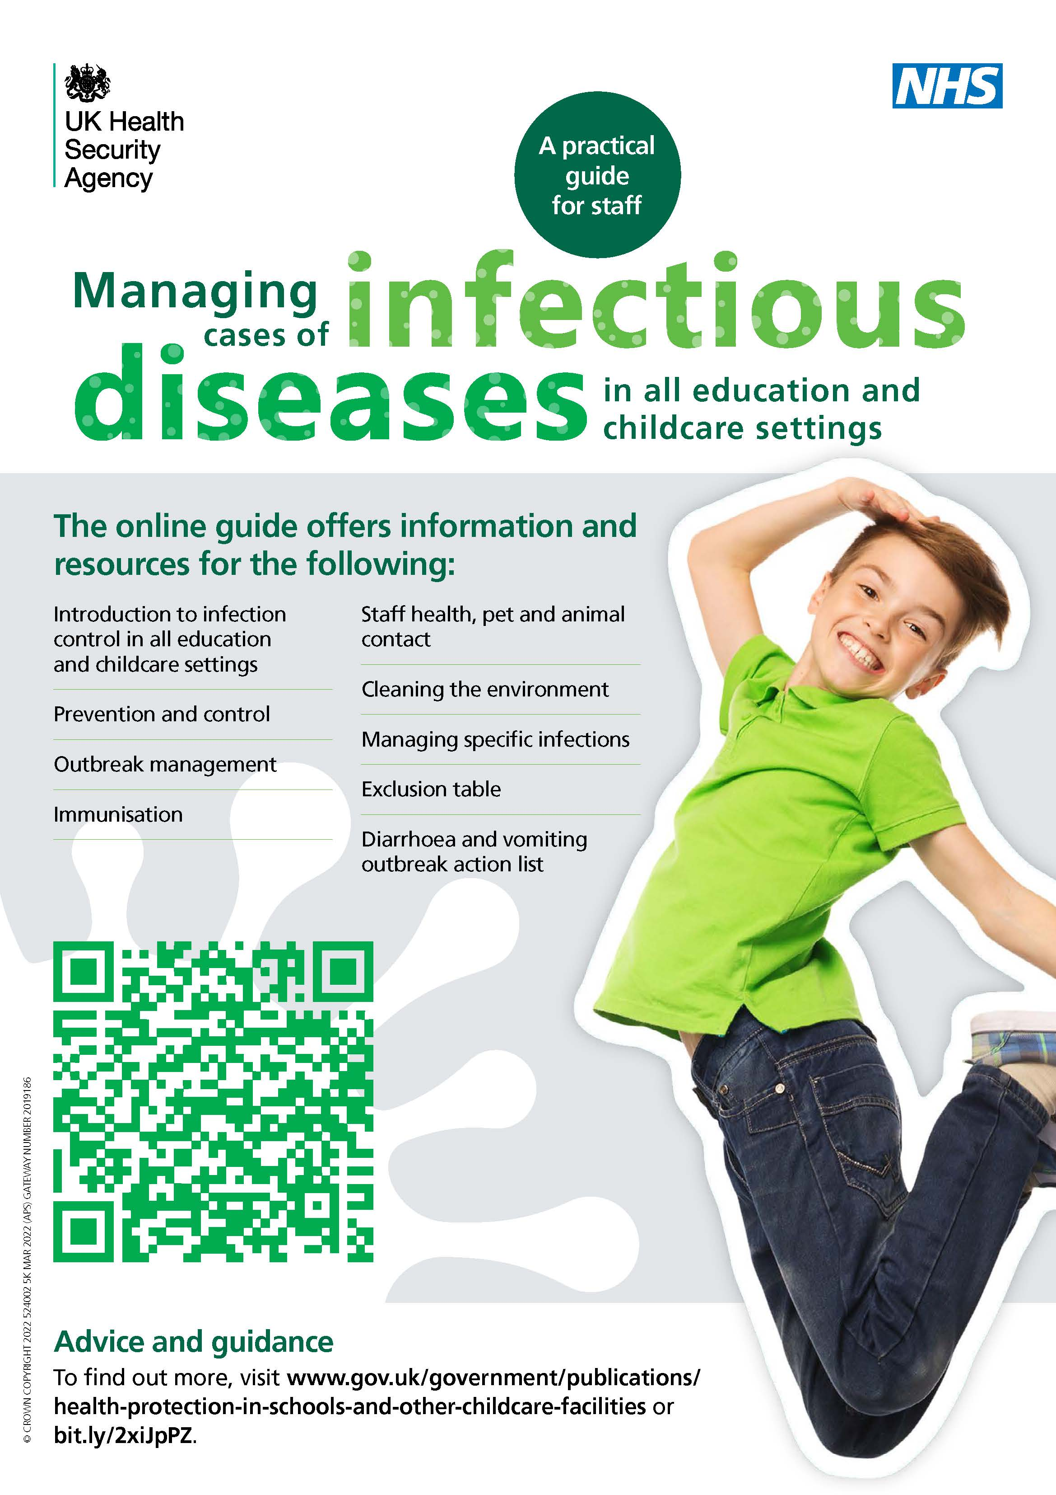
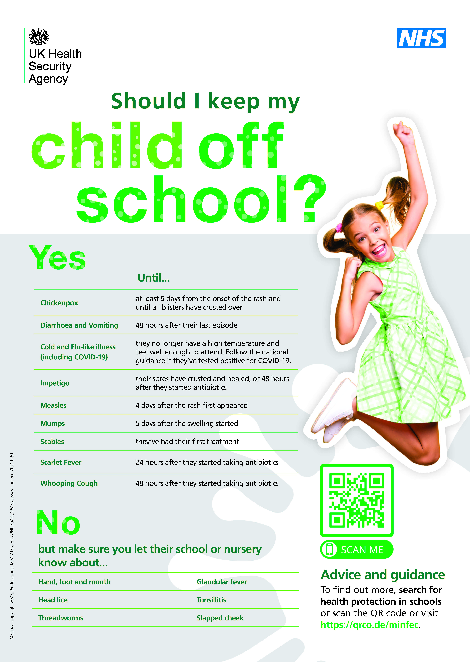
1
Notes:
Presenter notes: This just highlights some really useful posters that can be downloaded and displayed in your EYES. One give info on infectious diseases and the other gives info on whether children need to stay off school or other EYES

Slide 13
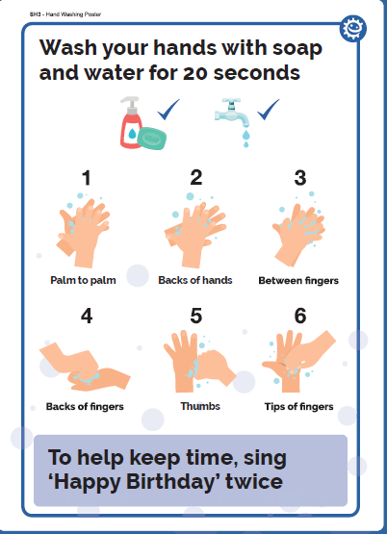
2a. Hand hygiene
2
Washing hands properly is one of the most important things we can do to help prevent and control the spread of many illnesses
Ensure that staff and students have access to liquid soap, warm water and paper towels.
Bar soap should not be used. NOTE: Alcohol hand gels do not kill norovirus.
Notes:
Presenter notes:
Cleaning hands is the most important way to prevent infections from spreading, but only if hands are cleaned property.
Hands can be cleaned either by washing them with liquid soap and water or using Alcohol based hand rubs (ABHR). ABHRs have become very common since COVID and used at the right time can be very effective.
There are steps that should be taken when cleaning hands to ensure the all surfaces of our hands have contact with soap and water or ABHRs. The steps can be seen on the poster on this slide. It is useful if you can have posters showing how hands can be cleaned so children and adults can follow it.
Dryings hands is just as important as cleaning them, so if soap and water is being used always encourage children and adults to dry their hands properly either with paper towels (usually more than one is needed), or hand dryers.
Hand dryers are fine to use, but children and staff should be encouraged to use them until their hands are completely dry. Please avoid communal use of fabric towels unless they are single use in home settings for drying hands.
If ABHRs are used please ensure they are positioned in a safe place where children cannot mis use it. ABHRs should never be used after using the toilet, hands should always be washed with liquid soap and water.
Key times to clean hands is
Before eating and/or preparing food
After using the toilet
When hands are visibly dirty
After blowing your nose, coughing or sneezing into hands.
Chapter 2: infection prevention and control - GOV.UK (www.gov.uk)
Campaign Resource Centre (phe.gov.uk)
e-Bug | England Home

Slide 14
2b. Respiratory and Cough hygiene
2
Coughs and sneezes spread diseases. Cover the nose and mouth during sneezing and coughing to reduce the spread of infections.
Have tissues readily available and accessible for children/young people
Cover nose and mouth with a tissue when coughing and sneezing, and dispose of used tissue in and perform hand hygiene
Cough or sneeze into the inner elbow (upper sleeve) if no tissues are available, rather than into the hand
keep contaminated hands away from eyes and nose
Notes:
Presenter notes:
Good respiratory hygiene will reduce the spread of respiratory infections. There are key hygiene measures that should be taught to children and practiced by children and adults. These include:
Covering the nose and mouth during sneezing and coughing to reduce the spread of infections.
Have tissues readily available and accessible for children/young people
Cover nose and mouth with a tissue when coughing and sneezing, and dispose of used tissue in a bin and wash your hands with soap and water
Cough or sneeze into the inner elbow (upper sleeve) if no tissues are available, rather than into the hand
keep contaminated hands away from eyes and nose

Slide 15
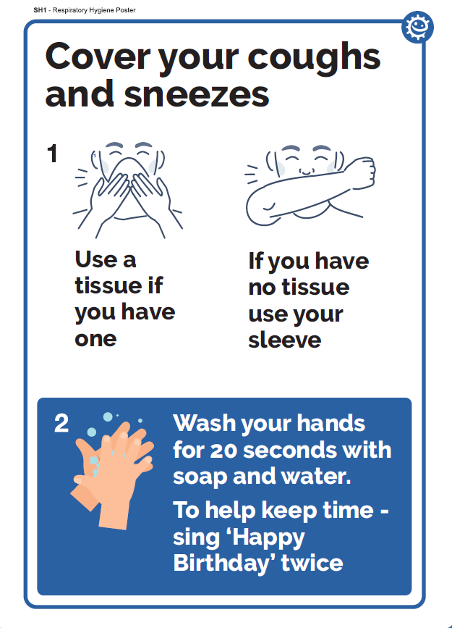
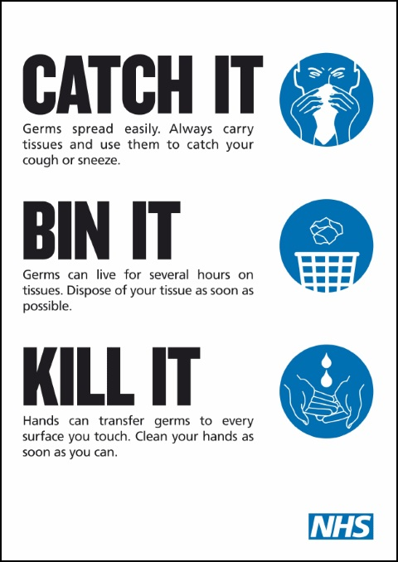
2
Notes:
Presenter notes:
Here is an example of a poster that could be displayed in your setting to remind children and adults to follow the correct respiratory hygiene.

Slide 16
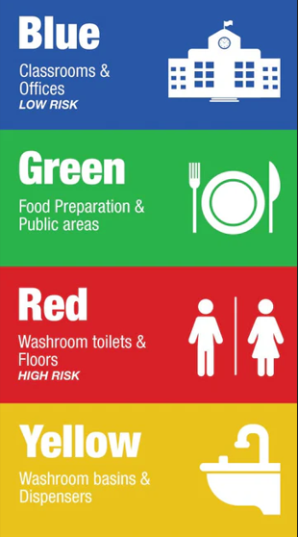

Cleaning
3
Effective cleaning and disinfection are critical in any setting
There are standards of cleaning that are expected in education and
early years settings
Detergents and disinfectants are useful and there are times when a detergent should be used and other time when a disinfectant is needed.
Cleaning schedules are useful to support routine cleaning and disinfection
Correct storage of cleaning equipment increases the effectiveness of cleaning
Notes:
Presenter Notes
Cleaning may not be part of your roles, so please think about who in your setting may need this information and pass it on
Cleaning and disinfection are critical in any setting to prevent infections spreading and will certainly help in EYES. First it is important to understand what methods of cleaning are available so you can ensure you pick the correct process and product in you’re your EYES.
To enable EYES to stay clean it is important that they are kept visibly clean, avoiding clutter (which can be challenging in EYES), but this will enable effective cleaning. Keeping EYES clean, including toys and equipment, reduces the risk of infection, particularly when food preparation is taking place.
EYES should always be well maintained, in a good state of repair, again this enables effective cleaning to take place.
Cleaning equipment used should be either disposable or if reusable, disinfected after each use
Clean touchable surfaces often e.g. door handles, switches, shared equipment.
Colour coded equipment can be used in different areas with separate equipment for kitchen, toilet and classroom areas.
It is important that immediate and safe cleaning of any spills of any body fluids is carried out.
In the event of an outbreak of infection at your setting, you may be advised to undertake enhanced or more frequent cleaning, to help reduce transmission.
Ventilation plays a big role in preventing infections, so adequate ventilation is very important. Where it is safe to do so have windows open can help dilute any microbes which might be circulating in the air. Windows do not to be wide open, just enough to allow air to flow into the space. Always balance this temperature comfort.
Cleaning with detergent and water
This physically removes contaminants and will often remove up to 80% of harmful microbes.
Cleaning with detergent and water is normally all that is needed as it removes most germs that can cause infection or diseases
Daily, weekly and periodic cleaning schedules should be in place for your EYES
Having hand touch surfaces on regular cleaning schedules can prevent outbreaks (such as door handles, and other high touch points, which may vary depending on your setting.
Cleanign with detergents
Cleaning and disinfection are critical in any setting to prevent infections spreading and will certainly help in EYES. First it is important to understand what methods of cleaning are available so you can ensure you pick the correct process and product in you’re your EYES.
Cleaning with a disinfection helps to reduce the number of harmful microbes but is not necessarily effective against all of them so always seek advice and read manufacturers instructions.
This should be carried out if there is a suspicion of an infection. Please remember disinfection can only take place after something has been cleaned. There are some products which have detergent and disinfection agent so can reduces the steps of the disinfection process.
In the event of an outbreak of infection at your setting, your UKHSA health protection team (HPT) may recommend enhanced or more frequent cleaning, to help reduce the spread.
Advice may also be given to increase cleaning of areas with particular attention to hand touch surfaces that can be easily contaminated such as door handles, toilet flushes, taps and communal touch areas.
Cleaning scedules
Cleaning schedules provide assurance of cleaning, which is helpful for providing cleaning assurances to those using your EYES, as well as organisations such as OFSTEAD.
Always ensure that your cleaning schedules include:
what needs to be cleaned- it is useful to break this into rooms and then what needs to be cleaned in each room- including high and low surfaces, equipment and high touch items.
who’s responsibility it is for cleaning/ or restocking such as soap dispensers (this may vary on the setting, and may include more than one person)
frequency of cleaning – again this may vary on what your setting is like, how many users there are and how quickly things get dirty or contaminated.
method of environmental decontamination (detergent/disinfectant). We spoke about this in a early slide. Toilets and sanitary areas should be disinfected.
Increased cleaning if an outbreak is known or suspected- advice can be sought from your Local HPT.
Storage of cleaning equipment
Clean and dry
Space to store equipment off the floor
Closed cupboards
Uncluttered
Mops should be hung inverted

Slide 17
Ventilation
4
Reduce circulation of respiratory infections by:
partially opening windows and doors to let fresh air in
opening higher level windows to reduce draughts
opening windows for 10 minutes an hour or longer can help increase ventilation
Balance need for good ventilation with maintaining a comfortable temperature
Notes:
Presenter notes
Ventilation is very important for preventing infections that spread through the air.
Simple steps to help reduce circulation of respiratory infections in particular include:
partially opening windows and doors to let fresh air in
opening higher level windows to reduce draughts
opening windows for 10 minutes an hour or longer can help increase ventilation – where possible this can happen when the room is empty

Slide 18
Vaccination
5
Did you know?
After clean water, vaccination is the most effective public health intervention in the world for saving lives and promoting good health.
Vaccines prevent up to 3 million deaths worldwide every year.
Notes:
Presenter notes:
After clean water, vaccination is the most effective public health intervention in the world for saving lives and promoting good health.
Vaccines prevent up to 3 million deaths worldwide every year
Since vaccines were introduced in the UK, diseases like smallpox, polio and tetanus that used to kill or disable millions of people are either gone or seen very rarely
Other diseases like measles and diphtheria have been reduced by up to 99.9% since their vaccines were introduced

Slide 19
Vaccination
5
Vaccine schedule: Provides early protection against infections that are most dangerous for the very young.
Booster (repeat) doses and the introduction of other vaccinations as the child gets older are scheduled to provide protection before they reach an age when they become most at risk of these vaccine-preventable diseases.
If people stop having vaccines, it's possible for infectious diseases to quickly spread again
Why vaccination is safe and important - NHS (www.nhs.uk)
Notes:
Presenter notes:
There is a vaccine schedule for babies and children which provides early protection against infections that are most dangerous for the very young.
Booster (repeat) doses and the introduction of other vaccinations as the child gets older are scheduled to provide protection before they reach an age when they become most at risk of these vaccine-preventable diseases.
If people stop having vaccines, it's possible for infectious diseases to quickly spread again. EYES have an opportunity to promote vaccine uptake in their settings and myth bust.
There is a useful document from the NHS that can be shared that talks about why vaccines are safe and important

Slide 20
How vaccination uptake can be improved
5
Highlight vaccination schedules to families on a regular basis
1
Work with vaccination teams so you know when immunisation campaigns take place
2
Share FAQs about vaccinations
3
Find appropriate times (assemblies) to talk to the children about vaccinations
4
Notes:
Presenter notes:
This shows us ways that EYES can help support uptake of vaccination:
Read through the slide points

Slide 21
Additional IPC considerations
Equipment
Where possible buy toys and equipment that can be easily cleaned
In an outbreak- remove toys and equipment that cannot be easily cleaned
store toys/equipment/ games in a clean container and do not let children take toys/equipment into toilet areas
Separate reusable equipment that has been cleaned from used equipment that needs cleaning
Other considerations
Ensure food hygiene guidance is followed at all times
Explore how hygiene principles can be embedded into subjects (www.e-Bug.eu)
Notes:
Presenter Notes
Additional IPC Considerations
For Equipment
where possible buy toys and equipment that can be easily cleaned
In an outbreak- remove toys and equipment that cannot be easily cleaned
store toys/equipment/ games in a clean container
do not let children take toys/equipment into toilet areas
store reusable equipment that has been cleaned but is not in use separately from used equipment and away from where equipment cleaning takes place
Other considerations
Ensure food hygiene guidance is followed at all times
Explore how hand washing and respiratory hygiene principles can be embedded into subjects so children are reminded of hygiene expectations in school settings (you can use e-Bug for this)

Slide 22
Additional IPC considerations - Personal Protective Equipment (PPE)
PPE can protect individuals from contamination with blood or bodily fluids
PPE is not usually required for day-to-day use in educational settings. If you are looking after children where PPE use has been identified, then you should continue to do that
When PPE is required
On suspicion of an infectious illness or disease
If there is a risk of splashing/contamination with blood or bodily fluids during an activity, wear disposable gloves and plastic aprons (e.g managing a nosebleed, or soiled clothing).
Fluid-resistant surgical facemasks can be used to prevent microbes that spread through the air from spreading to others, as well as protecting from splashes or bodily fluid exposure.
Always clean hands immediately after removing PPE and before touching anything else.
Notes:
Presenter Notes
Personal protective equipment -PPE can protect individuals and staff from contamination with blood or bodily fluids, which may contain germs that spread disease.
PPE is not usually required for day to day use in educational settings. If you are looking after children where PPE use has been identified, then you should continue to do that
When PPE is required
On suspicion of an infectious illness or disease
If there is a risk of splashing/contamination with blood or bodily fluids during an activity, wear disposable gloves and plastic aprons (e.g managing a nosebleed, or soiled clothing).
Fluid-resistant surgical facemasks can be used to prevent microbes that spread through the air from spreading to others, as well as protecting from splashes or bodily fluid exposure.
Always clean hands immediately after removing PPE and before touching anything else.

Slide 23
Ways to treat infections
Our immune system will fight off many common infections but, in some cases, it needs help
Antimicrobials are medicines used to kill or slow the growth of microbes
Antimicrobials can be grouped according to the micro-organisms
Bacteria
Viruses
Fungi
Parasites
antibiotics
antivirals
antifungals
antiparasitics
Notes:
Presenter notes:
Antimicrobials are medicines used to kill or slow the growth of microbes, which helps fight infections.
Depending on the type of microbe there are different types of antimicrobial and these are listed here (read from the slide).
Most of us are more aware of antibiocs, which only fight bacterial infections, which is why these are not prescribed when someone has a cold, flu, RSV or COVID.
The next slides will discuss how antibiotics are becoming resistance to some nasty bacterial infections.

Slide 24
Antimicrobial Resistance (AMR)
Antimicrobial resistance (AMR) occurs when microbes no longer respond to the drugs designed to kill them.
How AMR occurs:
Poor hygiene and sanitation
Over-use and miss use of antibiotics
Overuse of antibiotics in livestock and fish farming
People not finishing the entire antibiotic course

Slide 25
What can EYES do to prevent AMR
Prevent burden of infection
Encourage good hand and cough hygiene
Place posters around your setting to remind students of key behaviours (handwashing, covering coughs and colds)
Promote uptake of childhood and seasonal vaccinations
Hold an assembly on what antimicrobial resistance (AMR) is and why it matters
Ensure children and young people complete course of antibiotics during EYES time when prescribed
Signpost parents/families and staff to AMR information
Notes:
Presenters notes:
EYES can help prevent the burden of infection by
Encourage good hand and cough hygiene
Place posters around your setting to remind students/ young people of key behaviours (handwashing, covering coughs and cold)
Promote uptake of childhood and seasonal vaccinations
Schools can hold an assembly on what antimicrobial resistance (AMR) is and why it matters/ other settings could have newsletters going out with the same information on for parents/ carers.

Slide 26
Section 2 Infectious disease management and recognising when children/young people need to stay away from their Early Years and Educational Settings (EYES)

Slide 27
Section 2
Public health management of diseases in Early Years and Educational Settings (EYES)
What to do when you suspect an outbreak/incident in your setting
Top 5 reasons why EYES contact Health Protection Teams and how to manage suspected/confirmed cases
Notes:
Presenter Notes
This section will cover
Public health management of diseases in Early Years and Educational Settings (EYES)
What to do when you suspect an outbreak/incident in your setting
The top 5 reasons why Early Years and Educational Settings (EYES) contact Health Protection Teams and how to manage the suspected/confirmed cases

Slide 28
Public health management of diseases
Most infectious diseases in education and childcare settings can be managed by following the advice provided in Managing specific infectious diseases: A to Z - GOV.UK (www.gov.uk) and ensuring children, young people and staff follow the recommended exclusion periods.
Notes:
Presenter Notes
The link in the slide provides guidance on how to manage most infectious diseases in education and childcare settings. The resource is called “Managing specific infectious diseases A to Z” and it is available on the gov.uk website

Slide 29
If you suspect an outbreak or incident
Review and reinforce the baseline infection prevention and control measures they already have in place
Encourage all staff and students who are unwell to not attend the setting
Encourage all eligible groups to take up the offer of national vaccination programmes
Ensure occupied spaces are well ventilated and reinforce good hygiene practices such as frequent cleaning
Consider communications to raise awareness of the outbreak among parents/carers and reinforce key hygiene messages
Notes:
Presenter Notes
What do you do if you suspect an outbreak or incident in your setting.
Firstly, review and reinforce the baseline infection prevention and control measures you already have in place
Encourage all staff and students who are unwell to not attend the setting
Encourage all eligible groups to take up the offer of national immunisation programmes
Ensure occupied spaces are well ventilated and let fresh air in
Reinforce good hygiene practices such as frequent cleaning
Consider communications to raise awareness of the outbreak/incident among parents/carers and reinforce key messages, including the use of hand and respiratory hygiene measures

Slide 30
Who and when to contact?
When you have reviewed and are following national guidance per infection (IPC measures, exclusions etc.) and/or you still need some support to manage an outbreak
Contact the Health Protection Teams- https://www.gov.uk/health-protection-team
Make sure include details of infection, numbers affected, additional risk factors and contact details
Notes:
Presenter Notes
When you have reviewed and you are following national guidance per infection (IPC measures, exclusions etc.) and/or you still need some support to manage the outbreak
Contact your local Health Protection Teams using the website- https://www.gov.uk/health-protection-team
Make sure you include details of infection, numbers affected, additional risk factors and contact details

Slide 31
Top 5 reasons why EYES contact Health Protection Teams
Acute respiratory infections (ARIs)
Scarlet Fever
Chickenpox
Tummy Bugs (Gastrointestinal infections)
Hand, Foot and Mouth Disease
Notes:
Presenter Notes
Moving on to the third part of this section;
These are the top reasons why Early Years and Educational Settings across England contact their local contact Health Protection Teams
Acute respiratory infections (ARIs)
Scarlet Fever
Chickenpox
Tummy Bugs (Gastrointestinal infections)
Hand, Foot and Mouth Disease

Slide 32
Acute respiratory infections (ARIs)
Respiratory infections are common, particularly during winter months.
Symptoms can include a runny nose, high temperature , congestion, cough and sore throat.
Symptoms can be caused by several respiratory infections including the common cold, rhinovirus, COVID-19, and flu.
Respiratory tract infections (RTIs) - NHS (www.nhs.uk), Flu – NHS.UK
For most individuals, these illnesses are not serious and most recover quickly
Notes:
Presenter Notes
The first is Acute respiratory infections
Respiratory infections are common, particularly during winter months.
Symptoms can include a runny nose, high temperature , congestion, cough and sore throat.
Symptoms can be caused by several respiratory infections including the common cold, rhinovirus, COVID-19, and flu
Respiratory tract infections (RTIs) - NHS (www.nhs.uk), Flu – NHS.UK
For most individuals, these illnesses are not serious and most recover quickly

Slide 33
Managing cases and outbreaks of ARIs
Exclusion is recommended - Exclude any affected individual who has a high temperature and are unwell, until they no longer have a high temperature (without taking paracetamol) and are well enough to attend the setting.
Do not exclude individuals with mild symptoms such as a runny nose, sore throat, or mild cough, who are otherwise well.
Promote hand and respiratory hygiene measures
Cleaning and ventilation
Vaccinations (seasonal flu/covid/RSV) – for eligible children and adults
Managing specific infectious diseases: A to Z - GOV.UK (www.gov.uk)
Notes:
Presenter Notes
What to do when you have a suspected outbreak of acute respiratory infection in your settings
Exclusion is recommended (Exclusion is when a person is told not come into work/school).- Exclude any affected individual who has a high temperature and are unwell, until they no longer have a high temperature (without taking paracetamol) and are well enough to attend the setting
Do not exclude individuals with mild symptoms such as a runny nose, sore throat, or mild cough, who are otherwise well.
Promote hand and respiratory hygiene measures
Cleaning and ventilation
Vaccinations – for eligible children and adults
Please the link on the slide for more information

Slide 34
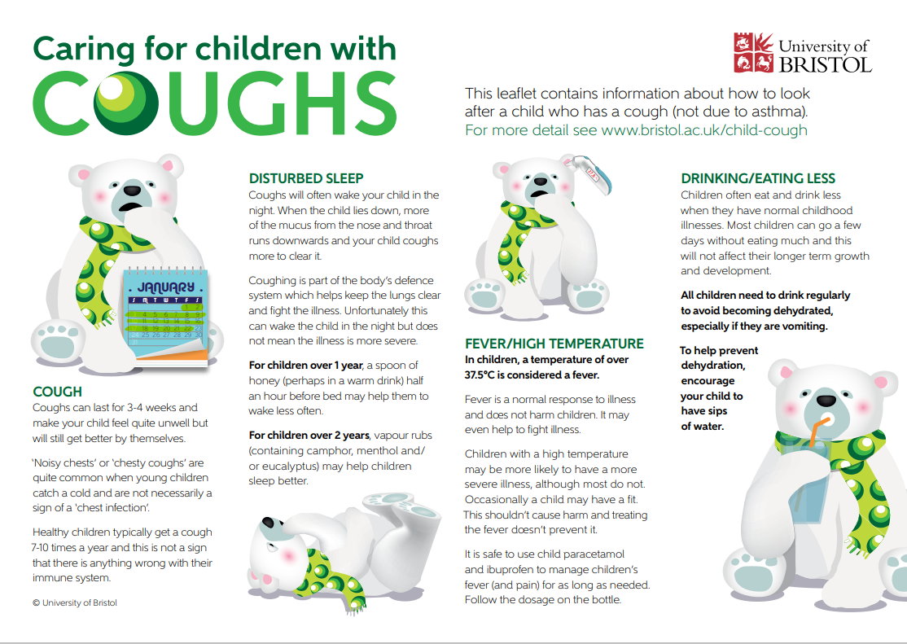
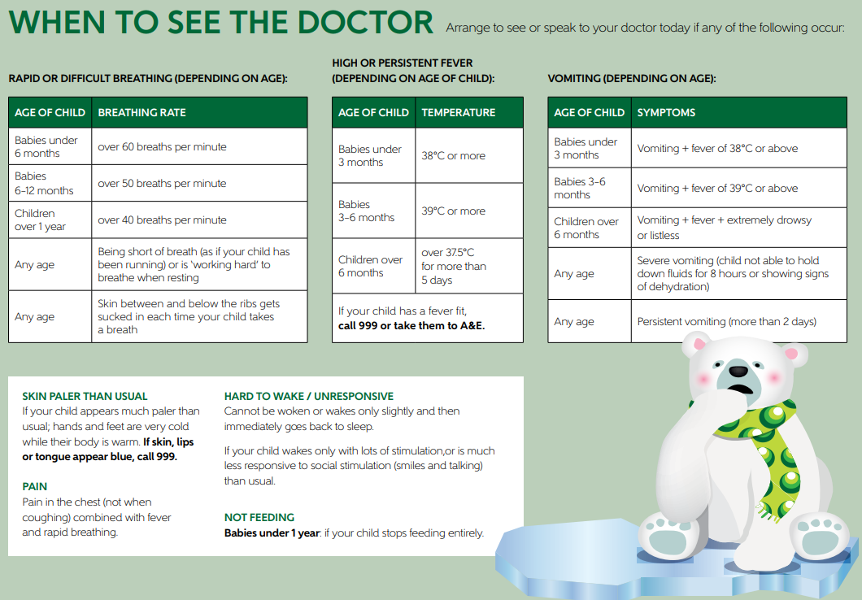
Caring for Babies and Children with Cough (bristol.ac.uk)
UoB_Childrens-cough_PDF-leaflet_A4.pdf (bpb-eu-w2.wpmucdn.com)
Notes:
Presenter Notes
Here are some more resources on how to care for children when they have a cough

Slide 35
When to contact HPTs– acute respiratory infections
If you are a setting that is dedicated to children who are clinically vulnerable.
If anyone is admitted to hospital (or there is a death).
If you are still getting SIGNIFICANT numbers of new cases after 3 WEEKS despite implementing all of the recommendations advised , and you are still concerned about the situation.
If you have further issues stopping you from implementing control measures.
Notes:
Presenter Notes
Although you are not required to report outbreaks of acute respiratory infections, these are times when it is appropriate to let your local Health Protection team know if you have an outbreak:
If you are a setting that is dedicated to children who are clinically vulnerable.
If anyone is admitted to hospital (or there is a death).
If you are still getting SIGNIFICANT numbers of new cases after 3 WEEKS despite implementing all of the recommendations advised, and you are still concerned about the situation.
If you have further issues stopping you from implementing control measures.

Slide 36
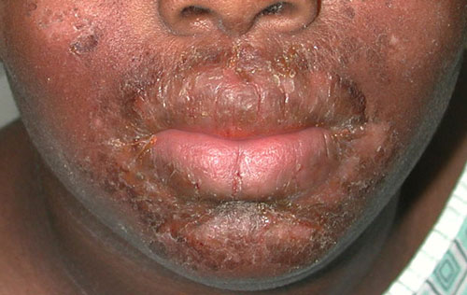
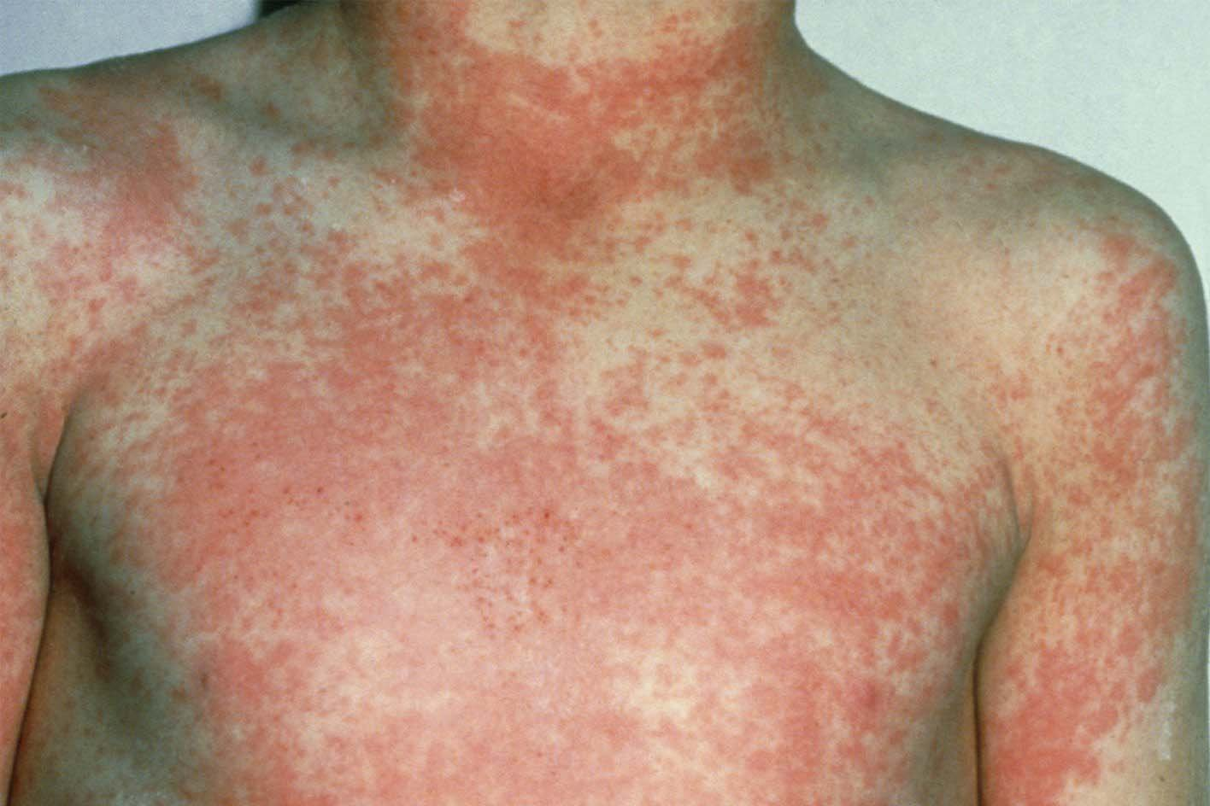
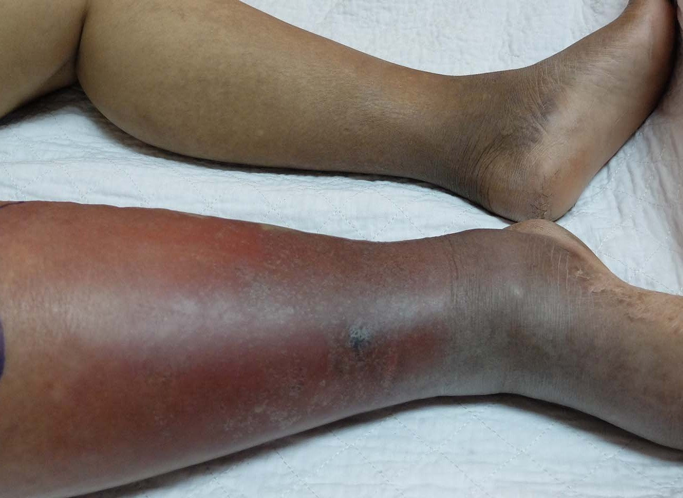
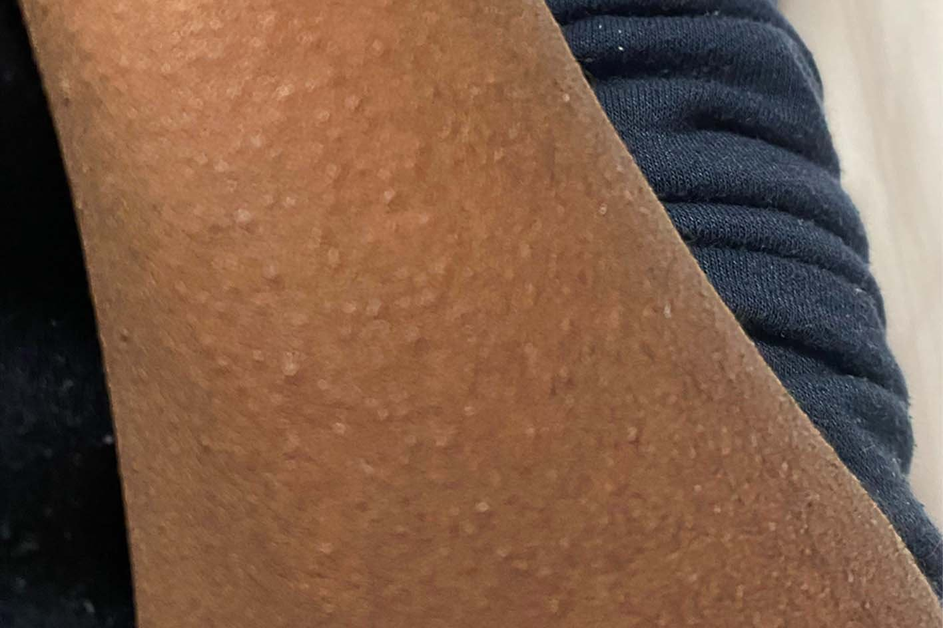
Scarlet Fever
Scarlet fever is caused by the Group A streptococcus (GAS) bacteria which also causes other infections like:
Impetigo
Cellulitis
‘Strep’ throat
Impetigo
Scarlet fever
Cellulitis
Scarlet fever
Notes:
Presenter Notes
Scarlet fever.
This is caused by the Group A streptococcus bacteria (also known GAS) which also causes other infections like:
Impetigo
Cellulitis
‘Strep’ throat
And so on

Slide 37
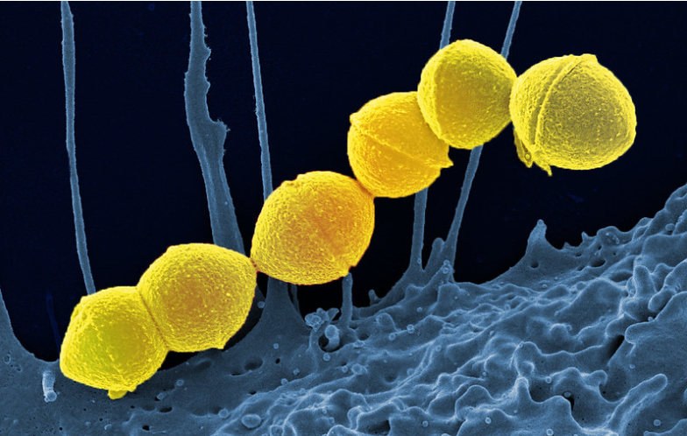
Group A Streptococcus (GAS)
Group A Strep - What you need to know - UK Health Security Agency (blog.gov.uk)
1 in 100 people carry on skin/ throat with no symptoms
Can be treated with antibiotics if causing illness
Notes:
Presenter Notes
Group A streptococcus (GAS), also referred to as Strep A is a common bacterium. Lots of us carry it in our throats and on our skin and it doesn’t always result in illness.
However, GAS causes a number of infections; some mild and some more serious.

Slide 38
Scarlet Fever and Chicken pox together
Children who have had chickenpox recently are more likely to develop more serious infection during an outbreak of scarlet fever and so parents should remain vigilant
Individuals should be excluded from setting until at least 24 hours after starting antibiotics. Individuals who do not take antibiotic treatment will be infectious for two to three weeks.
Be extra vigilant if there are 2 or more scarlet fever AND 2 or more chicken pox cases in the same group of children (e.g. class)
Notes:
Presenter Notes
Children who have had chickenpox recently are more likely to develop more serious infection during an outbreak of scarlet fever and so parents should remain vigilant
Individuals should be excluded from setting until at least 24 hours after starting antibiotics. Individuals who do not take antibiotic treatment will be infectious for two to three weeks.
Be extra vigilant if there are 2 or more scarlet fever AND 2 or more chicken pox cases in the same group of children (e.g. class)

Slide 39
When to call for support- GAS & Chickenpox/ARIs
If anyone is admitted to hospital (or there is a death) due to GAS
If you are a setting that is dedicated to children who are clinically vulnerable
If you have chicken pox AND GAS circulating in the same class or year group at the same time
If you think you have cases of confirmed flu AND scarlet fever / GAS in the SAME CLASS (not just the same year group).
If you are still getting SIGNIFICANT numbers of new cases after 3 weeks despite implementing all of the recommendations advised and you are still concerned about the situation
If you have further issues that are stopping, you applying the steps mentioned
Notes:
Presenter Notes
When to contact your local health team for support:
If anyone is admitted to hospital (or there is a death) due to GAS
If you are a setting that is dedicated to children who are clinically vulnerable
If you have chicken pox AND GAS circulating in the same class or year group at the same time
If you are still getting SIGNIFICANT numbers of new cases after 3 weeks despite implementing all of the recommendations advised and you are still concerned about the situation
If you have further issues that are stopping you applying the steps mentioned

Slide 40
Tummy bugs (Gastrointestinal infections)
Tummy bugs (GI) include food poisoning, gastroenteritis and norovirus. These infections spread when the germs enter the gut via the mouth.
Facts about Norovirus:
Symptoms start suddenly and include feeling sick, tummy aches, diarrhoea and/or vomiting
People will be ill from about 12 hours to 3 days.
You will often find a pattern of cases happening over a few days.
Children and employees can become ill with norovirus.
A high temperature is not usually a symptom
Notes:
Presenter Notes
Tummy Bugs are also known as Gastrointestinal infections. They include food poisoning, gastroenteritis and norovirus. They occur when germs enter the gut via the mouth.
For norovirus:
Symptoms start suddenly and include feeling sick, tummy aches, diarrhoea and/or vomiting
People will be ill from about 12 hours to 3 days. You can start to feel ill from 24-48 hours after being in contact with the virus.
You will often find a pattern of cases happening over a few days.
Children and employees can become ill with norovirus.
A high temperature is not usually a symptom

Slide 41
Managing cases and outbreaks of GI
Make sure all children and employees that are ill stay away until they have been better for 2 days (48 hours)
Clean up any sick or poo straight away using a household detergent and single use cloth. Then disinfect with a hypochlorite solution (e.g. Milton).
Tell parents and visitors about the cases of illness
Promote and reinforce hand hygiene with all employees
Cleaning (toilets, frequent touch points, mats etc)! Don’t hoover....
Until you are free of illness, we recommend you stop messy play, and don’t go on any visits out of your setting
After 48hrs with no cases, do a full clean of the building and all surfaces.
Notes:
Presenter Notes
How to manage cases and outbreak of Gastrointestinal infections/Tummy bugs
Make sure all children and employees that are ill go home and stay away until they have been better for at least 2 days (48 hours)
Clean up any sick or poo straight away using a household detergent and single use cloth. Then disinfect the area with a hypochlorite solution (e.g. Milton).
Tell parents and visitors about the cases of illness
All employees should make sure they are washing their hands regularly with soap and water.
Ensure proper cleaning especially in toilets, frequent touch points, mats etc)! Don’t just hoover....
Until you are free of illness, we recommend you stop messy play, remove soft toys that are tricky to clean, and don’t go on any visits out of your setting
After 48hrs with no cases, do a full clean of the building and all surfaces etc

Slide 42
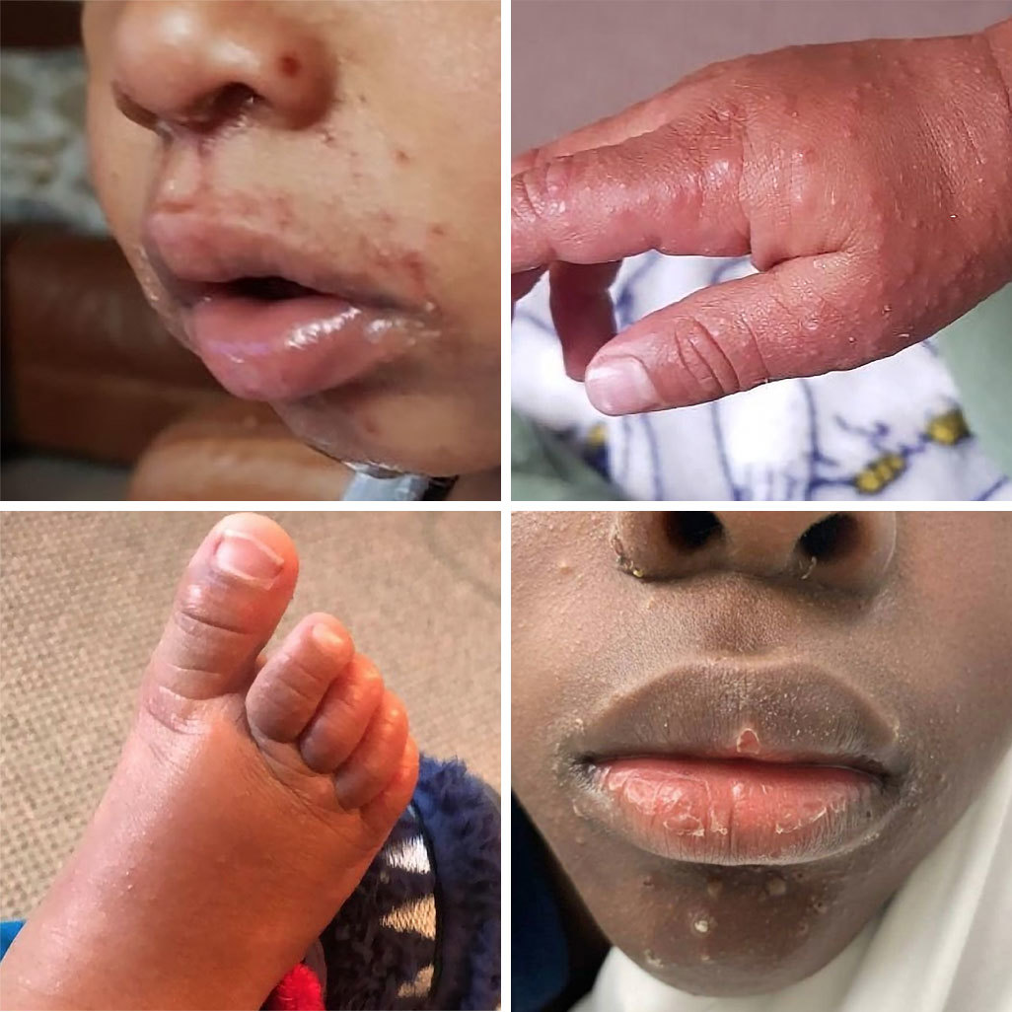
Hand, Foot and Mouth (HFM)
HFM mainly occurs in children under ten years of age, but adult cases are not unusual.
It is spread by direct contact with nasal and throat secretions or faeces of the infected person
Exclusion is not required
Pregnancy
It is advised that pregnant women should avoid close contact with a child who has hand, foot and mouth disease. Pregnant women who develop any symptoms of rashes during pregnancy should seek advice from their general practitioner or midwife.
Managing specific infectious diseases: A to Z - GOV.UK (www.gov.uk)
Hand, foot and mouth disease - NHS (www.nhs.uk)
Notes:
Presenter Notes
Hand, foot and mouth mainly occurs in children under ten years of age, but adult cases are not unusual.
It is spread by direct contact with nasal and throat secretions or faeces of the infected person
In cases of Hand, foot and mouth, Exclusion is not required
Pregnancy
Although there's usually no risk to the pregnancy or baby, it's best to avoid close contact with anyone who has hand, foot and mouth disease. Pregnant women who develop any symptoms of rashes during pregnancy should seek advice from their general practitioner or midwife.
There are links on the slide for more information on Hand, Foot and Mouth Disease from gov.uk and NHS websites

Slide 43
Key Guidance
Health protection in children and young people settings, including education - GOV.UK
Managing specific infectious diseases: A to Z - GOV.UK (www.gov.uk)
People with symptoms of a respiratory infection including COVID-19 - GOV.UK (www.gov.uk)
Living safely with respiratory infections, including COVID-19 - GOV.UK (www.gov.uk)
Emergency planning and response for education, childcare, and children’s social care settings - GOV.UK (www.gov.uk)
Notes:
Ask about these resources…what is normally use

