Slide 1
Infections in EYES
Infections are common and for most people the risk of severe disease is low
Infections can be picked up anywhere
Infections are caused by microbes (or germs) such as bacteria, viruses, fungi, and parasites
Microbes are everywhere and most do not cause infection and can even be beneficial
However, some microbes can cause infections when they get into the wrong place, which can result in symptoms such as fever and sickness.
Disease causing microbes are known as pathogens
Notes:
Presenter notes:
Infections are really common, and for most people the risk of complications or severe disease really quite low.
Infections can be picked up anywhere, at home or in the wider community so are often brought into EYES or picked up and spread within the EYES setting itself
Infections are caused by microbes (or germs) such as bacteria, viruses, fungi, and parasites
Microbes are everywhere, the live on our skin and in the environment and most do not cause infection and can even be beneficial . Bacteria on our skin, in our airways, and in our digestive system are the first line of defence against microbes that can cause infection.
However, some microbes/germs can cause infections when they get into the wrong place, which can result in symptoms such as fever and sickness.
Disease causing microbes are known as pathogens

Slide 2
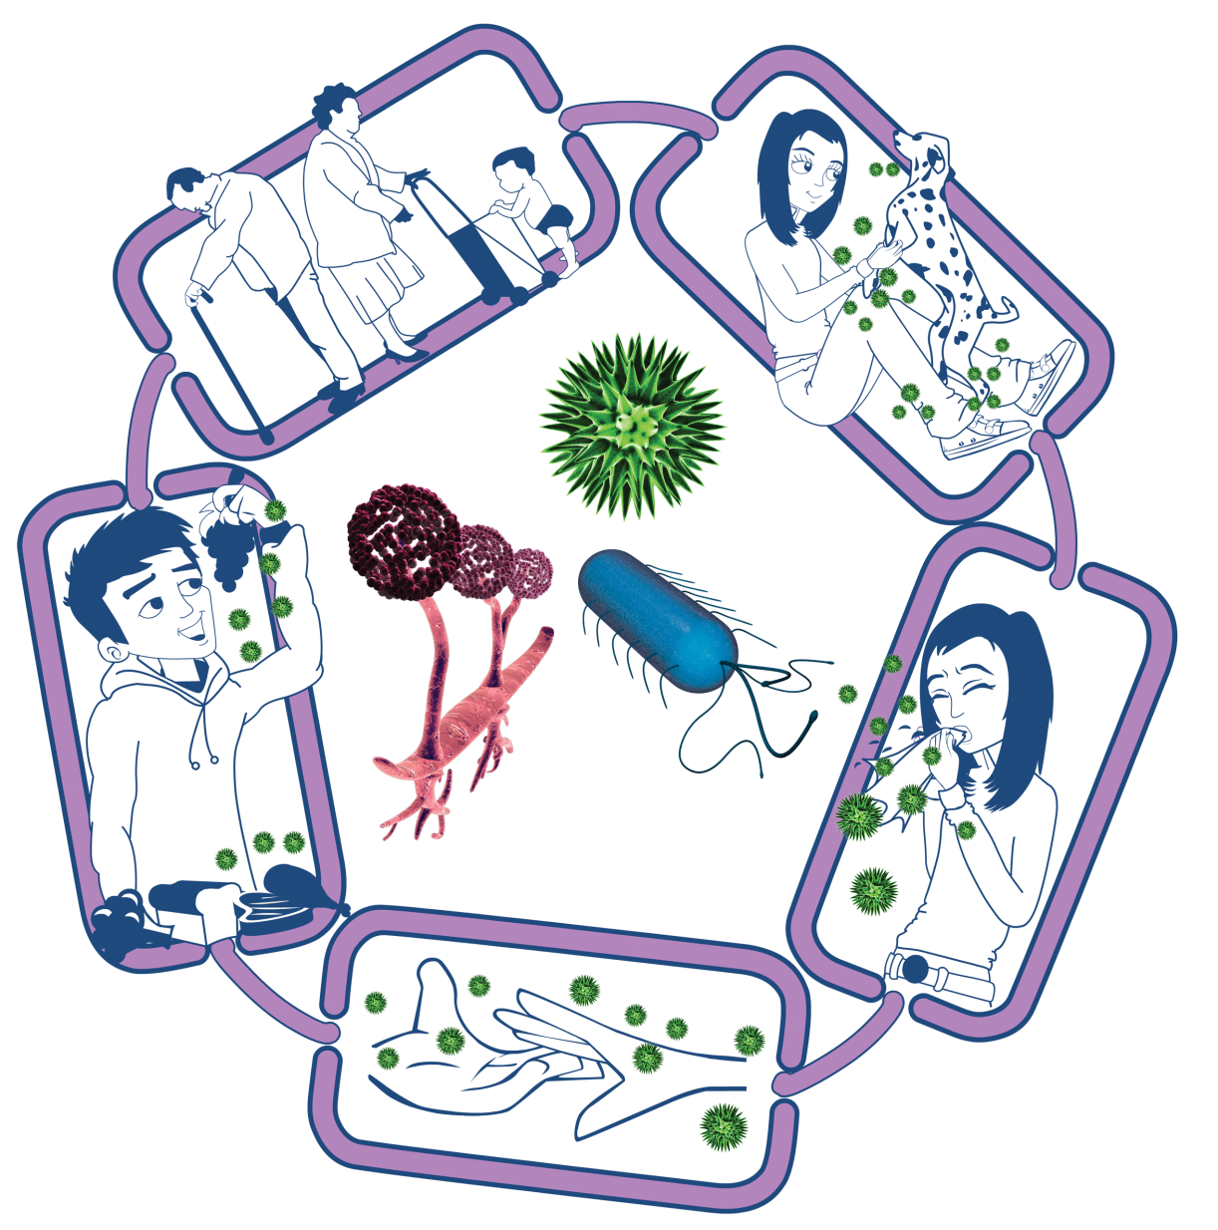
How infections spread- The Chain of Infection
People at risk from
infection
We are all at risk from
infection, but some are at greater risk:
• People on medication
e.g chemotherapy
• The very young/elderly
• People with underlying diseases e.g HIV/AIDS, diabetes
Source of infection
Someone or something carrying the harmful microbes that causes the infection. There are many different sources of infection, these can include:
• People already infected
• Pets or animals
• Contaminated food
Way out for microbes
Harmful microbes need a way to get out of an infected person or source before they can spread to someone else. Routes include:
• Sneezing, coughing, saliva
• Bodily fluid
• Juices from raw meat and poultry
Way in for microbes
Harmful microbes need a
way to enter the body before they can cause an infection. This can be
through:
• The food we eat
• Inhalation of aerosols
or droplets
• Open cuts or sores
• Things we put in our
mouths
Spread of infection
Harmful microbes need a way to be passed from a source to a person. This can be through:
• Direct touch/contact
• Sexual transmission
Harmful microbes are also spread via:
• Hands, hand contact surfaces (e.g. door handles, keyboards, toilets)
• Food contact surfaces
• Air
Notes:
Presenter notes:
The chain of infection helps us to understand how infections spread. Each chain in the infection has to come together for an infection to occur; by understanding this chain, we can then look for opportunities to break the chain, which in turn can help prevent infections from spreading to others. The chain of infection can be broken at any link, and the more links that can be broken, then less chance there is of an infection happening.
There are 5 links to this chain of infection and we will discuss each one in turn.
The source of infection is where the harmful microbe is, this can be people who are already infected (and we don’t always know if someone is infected), pets and animals and also contaminated food or contaminated surfaces.
The second link is way out for microbes: this means that the harmful microbe has to have a way of getting out of an infected person or other source before it can spreads to someone else. Ways this can happen is by sneezing, coughing, bodily fluids, or juices from raw meat and poultry.
The 3rd link is spread of infection. This is the easiest link to break. There are many key hygiene measures that we can do to ensure infections do not spread to others, which we will explain later on. There are many ways that harmful microbes can spread, direct contact, through the air and through indirect contact with surfaces or the environment.
The 4th link is way in for microbes, so just like the way out link, harmful microbes need a way of getting into a person’s body, which can be through the food we eat, inhaling infections that spread though the air, through open cuts and sores and through things that we put in our mouths (usually via our hands).
The last link in the chain is people at risks of infection. This is probably the one link that we have little control over. Everyone is at risk of infection but there will be some people who are at higher risk than others, such as people who are taking medications for example chemotherapy which weakens their immune system. , the very young and the elderly and people who have underlying health conditions. We see many grandparents now taking on the role of helping with child care, who may have underlying health conditions, therefore it is even more important that we consider this population when considering risks in EYES.
Now we understand the chain of infection, we can go into more details on the common modes of infection transmission

Slide 3
Common Modes of Transmission for EYES
Direct Contact
From the infected area/person to another person’s body
Through the air (aerosol)
Faecal-oral
Gastro-intestinal infections can spread from person to person
Usually via hands or via contact with a contaminated surface.
This is the most common way an infection can spread
Examples include scabies, headlice, ringworm and impetigo.
Aerosols can contaminate hands, cups, toys, or other items and spread to those who may use or touch them.
Examples include common cold, COVID-19, influenza, and whooping cough.
From the infected person to another person
Can spread without necessarily having close contact
Examples include norovirus and E.coli
When infected faeces (poo) or vomit are transferred to the mouth either directly or from contaminated food, water, or objects such as toys, door handles or toilet flush handles.
Usually via sneezing, coughing, singing, and talking
Notes:
Presenter notes:
The 3 main transmission routs that are seen in EYES include direct contact, through the air and faecal oral transmission.
Direct contact is the most common way infections can spread from one person to another, usually by hands touching an infected person or a contaminated surface. Examples of infections of the skin, mouth and eye that are spread in this way are scabies, headlice, ringworm and impetigo.
Through the air is a new terminology (it used to be called airborne or respiratory droplets, this is no longer used as the distinction between the two are not clearly distinguishable, so are now under the umbrella of through the air). Infection that spread through the air spread easily between people. Sneezing, coughing, singing, and talking may spread from an infected person to someone close by
Infections that spread through the air can also spread without necessarily having close contact with another person. When infected, a person's mouth or nose may also contaminate hands, cups, toys, or other items and spread to those who may use or touch them, particularly if they then touch their nose or mouth.
Examples of infections that are spread in this way are the common cold, COVID-19, influenza, and whooping cough
And lastly Faecal-oral mode of transmission. This is when gastro-intestinal infections spread from person to person when infected faeces or vomit are transferred to the mouth either directly from hands or from contaminated food, water, or objects such as toys, door handles or toilet flush handles. Examples of infections spread in this way include hepatitis A, Shiga Toxin-producing Escherichia Coli (STEC), and norovirus

Slide 4
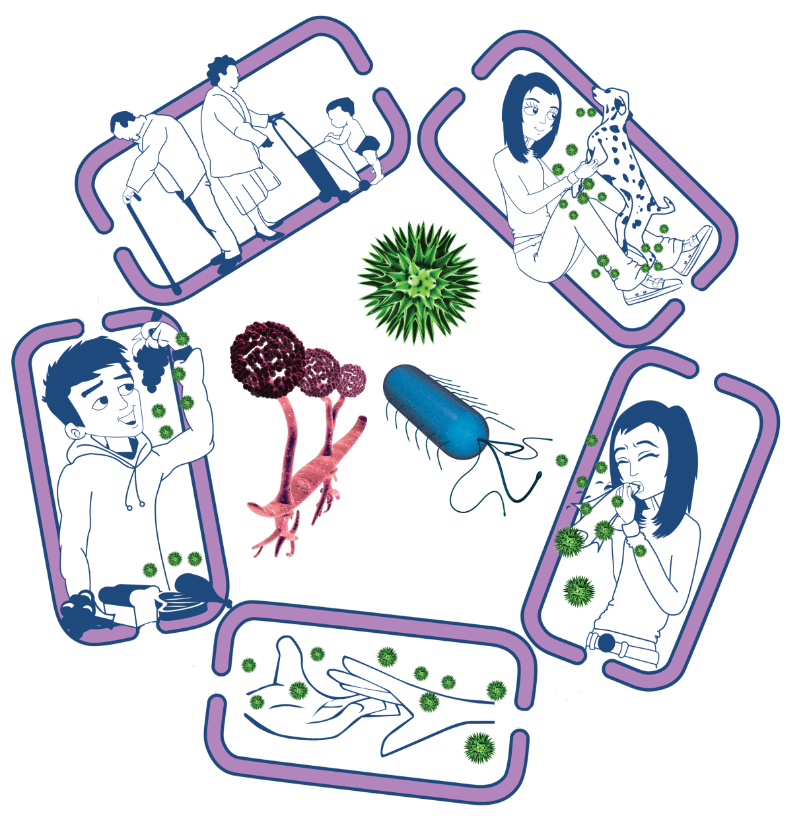
Breaking the Chain of Infection
People at risk from
infection
Everyone:
• Take appropriate vaccinations
High risk people:
• Keep away from people who are infectious
• Take extra care about cleanliness
• Take extra care when cooking and preparing food
Source of infection
• Isolate infected people
• Take care with raw food
• Wash pets regularly
• Treat pets for pathogens when needed
• Dispose of nappies and soiled clothing appropriately
Way out for microbes
Prevent any:
• Coughs and sneezes
• Faeces
• Vomit
• Bodily fluid
Getting onto surfaces or hands
Way in for microbes
• Cover cuts and open sores with a waterproof dressing
• Cook food properly
• Take care to drink only clean water
Spread of infection
• Wash hands thoroughly and regularly
• Cover cuts and open sores
• Take appropriate precautions during sexual activity

