Slide 1

Five key hygiene and prevention measures
Ventilation
Wash your hands!
Catch your coughs!
3
Environmental cleaning
2
4
Vaccination
5
Stay at home if unwell
1
These measures are very effective in preventing the spread of infections
Chapter 2: infection prevention and control - GOV.UK (www.gov.uk)
Notes:
Presenters notes
We are now going to go through key hygiene and prevention measures that can help us to break the chain of infection.
We have placed these into 5 categories which we will discuss through the next few slides. These categories are:
Stay at home if you are unwell
Wash hands and catch coughs
Ventilation
Environmental cleaning
And vaccination

Slide 2
Staying at home if unwell
1
Children who are unwell should not attend the setting and should remain at home until their acute symptoms resolve. This has always been the case.
Public health exclusions refers to the time period an individual should not attend a setting to reduce the risk of transmission during the infectious stage. This is different to ‘exclusion’ as used in an educational sense.
Different infections can have different exclusion periods or none at all - for more information visit Chapter 3: public health management of specific infectious diseases - GOV.UK (www.gov.uk)
Examples of acute symptoms with which children should not attend school/nursery include fever, muscle aches, hacking cough, D&V or specific diagnoses (e.g. chickenpox) that carry an exclusion. Examples of symptoms with which children could attend school/ nursery include persistent runny nose, irritable cough
Notes:
Presenter note:
Staying at home if unwell is really important, because it stops infections from spreading to others. We appreciate that its very inconvenient for parent to keep children away from EYES as it impacts their work, but it is really important that clear polices are in place, so it is clear on expectations around keeping children off from EYES if they are unwell.
It is important that exclusion periods are kept to, and these will differ depending on the microbe that is causing the infection.

Slide 3
A high temperature!!
1
A high temperature is the body's natural response to fighting infections like coughs and colds.
High temperature (fever) in children - NHS (www.nhs.uk)
A normal temperature in babies and children can vary slightly from child to child.
A high temperature is 38⁰C or more.
Is my child too ill for school? - NHS (www.nhs.uk)
If your child has a high temperature, keep them off school until it goes away.
Notes:
Presenters notes:
A high temperature is usually a certain sign that there is an infection. It is important that EYES know what a normal temperature is and this can vary slightly between children.
It is important to know that a high temperature is 38 degrees Celsius or more
There are some useful resources on NHS website which gives helpful advice.

Slide 4
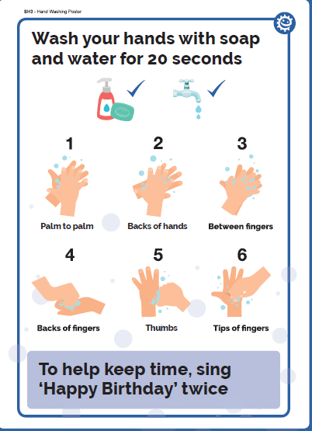
2a. Hand hygiene
2
Washing hands properly is one of the most important things we can do to help prevent and control the spread of many illnesses
Ensure that staff and students have access to liquid soap, warm water and paper towels.
Bar soap should not be used. NOTE: Alcohol hand gels do not kill norovirus.
Notes:
Presenter notes:
Cleaning hands is the most important way to prevent infections from spreading, but only if hands are cleaned property.
Hands can be cleaned either by washing them with liquid soap and water or using Alcohol based hand rubs (ABHR). ABHRs have become very common since COVID and used at the right time can be very effective.
There are steps that should be taken when cleaning hands to ensure the all surfaces of our hands have contact with soap and water or ABHRs. The steps can be seen on the poster on this slide. It is useful if you can have posters showing how hands can be cleaned so children and adults can follow it.
Dryings hands is just as important as cleaning them, so if soap and water is being used always encourage children and adults to dry their hands properly either with paper towels (usually more than one is needed), or hand dryers.
Hand dryers are fine to use, but children and staff should be encouraged to use them until their hands are completely dry. Please avoid communal use of fabric towels unless they are single use in home settings for drying hands.
If ABHRs are used please ensure they are positioned in a safe place where children cannot mis use it. ABHRs should never be used after using the toilet, hands should always be washed with liquid soap and water.
Key times to clean hands is
Before eating and/or preparing food
After using the toilet
When hands are visibly dirty
After blowing your nose, coughing or sneezing into hands.
Chapter 2: infection prevention and control - GOV.UK (www.gov.uk)
Campaign Resource Centre (phe.gov.uk)
e-Bug | England Home

Slide 5
2b. Respiratory and Cough hygiene
2
Coughs and sneezes spread diseases. Cover the nose and mouth during sneezing and coughing to reduce the spread of infections.
Have tissues readily available and accessible for children/young people
Cover nose and mouth with a tissue when coughing and sneezing, and dispose of used tissue in and perform hand hygiene
Cough or sneeze into the inner elbow (upper sleeve) if no tissues are available, rather than into the hand
keep contaminated hands away from eyes and nose
Notes:
Presenter notes:
Good respiratory hygiene will reduce the spread of respiratory infections. There are key hygiene measures that should be taught to children and practiced by children and adults. These include:
Covering the nose and mouth during sneezing and coughing to reduce the spread of infections.
Have tissues readily available and accessible for children/young people
Cover nose and mouth with a tissue when coughing and sneezing, and dispose of used tissue in a bin and wash your hands with soap and water
Cough or sneeze into the inner elbow (upper sleeve) if no tissues are available, rather than into the hand
keep contaminated hands away from eyes and nose

Slide 6
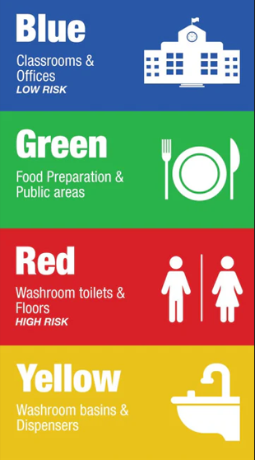

Cleaning
3
Effective cleaning and disinfection are critical in any setting
There are standards of cleaning that are expected in education and
early years settings
Detergents and disinfectants are useful and there are times when a detergent should be used and other time when a disinfectant is needed.
Cleaning schedules are useful to support routine cleaning and disinfection
Correct storage of cleaning equipment increases the effectiveness of cleaning
Notes:
Presenter Notes
Cleaning may not be part of your roles, so please think about who in your setting may need this information and pass it on
Cleaning and disinfection are critical in any setting to prevent infections spreading and will certainly help in EYES. First it is important to understand what methods of cleaning are available so you can ensure you pick the correct process and product in you’re your EYES.
To enable EYES to stay clean it is important that they are kept visibly clean, avoiding clutter (which can be challenging in EYES), but this will enable effective cleaning. Keeping EYES clean, including toys and equipment, reduces the risk of infection, particularly when food preparation is taking place.
EYES should always be well maintained, in a good state of repair, again this enables effective cleaning to take place.
Cleaning equipment used should be either disposable or if reusable, disinfected after each use
Clean touchable surfaces often e.g. door handles, switches, shared equipment.
Colour coded equipment can be used in different areas with separate equipment for kitchen, toilet and classroom areas.
It is important that immediate and safe cleaning of any spills of any body fluids is carried out.
In the event of an outbreak of infection at your setting, you may be advised to undertake enhanced or more frequent cleaning, to help reduce transmission.
Ventilation plays a big role in preventing infections, so adequate ventilation is very important. Where it is safe to do so have windows open can help dilute any microbes which might be circulating in the air. Windows do not to be wide open, just enough to allow air to flow into the space. Always balance this temperature comfort.
Cleaning with detergent and water
This physically removes contaminants and will often remove up to 80% of harmful microbes.
Cleaning with detergent and water is normally all that is needed as it removes most germs that can cause infection or diseases
Daily, weekly and periodic cleaning schedules should be in place for your EYES
Having hand touch surfaces on regular cleaning schedules can prevent outbreaks (such as door handles, and other high touch points, which may vary depending on your setting.
Cleanign with detergents
Cleaning and disinfection are critical in any setting to prevent infections spreading and will certainly help in EYES. First it is important to understand what methods of cleaning are available so you can ensure you pick the correct process and product in you’re your EYES.
Cleaning with a disinfection helps to reduce the number of harmful microbes but is not necessarily effective against all of them so always seek advice and read manufacturers instructions.
This should be carried out if there is a suspicion of an infection. Please remember disinfection can only take place after something has been cleaned. There are some products which have detergent and disinfection agent so can reduces the steps of the disinfection process.
In the event of an outbreak of infection at your setting, your UKHSA health protection team (HPT) may recommend enhanced or more frequent cleaning, to help reduce the spread.
Advice may also be given to increase cleaning of areas with particular attention to hand touch surfaces that can be easily contaminated such as door handles, toilet flushes, taps and communal touch areas.
Cleaning scedules
Cleaning schedules provide assurance of cleaning, which is helpful for providing cleaning assurances to those using your EYES, as well as organisations such as OFSTEAD.
Always ensure that your cleaning schedules include:
what needs to be cleaned- it is useful to break this into rooms and then what needs to be cleaned in each room- including high and low surfaces, equipment and high touch items.
who’s responsibility it is for cleaning/ or restocking such as soap dispensers (this may vary on the setting, and may include more than one person)
frequency of cleaning – again this may vary on what your setting is like, how many users there are and how quickly things get dirty or contaminated.
method of environmental decontamination (detergent/disinfectant). We spoke about this in a early slide. Toilets and sanitary areas should be disinfected.
Increased cleaning if an outbreak is known or suspected- advice can be sought from your Local HPT.
Storage of cleaning equipment
Clean and dry
Space to store equipment off the floor
Closed cupboards
Uncluttered
Mops should be hung inverted

Slide 7
Ventilation
4
Reduce circulation of respiratory infections by:
partially opening windows and doors to let fresh air in
opening higher level windows to reduce draughts
opening windows for 10 minutes an hour or longer can help increase ventilation
Balance need for good ventilation with maintaining a comfortable temperature
Notes:
Presenter notes
Ventilation is very important for preventing infections that spread through the air.
Simple steps to help reduce circulation of respiratory infections in particular include:
partially opening windows and doors to let fresh air in
opening higher level windows to reduce draughts
opening windows for 10 minutes an hour or longer can help increase ventilation – where possible this can happen when the room is empty

Slide 8
Vaccination
5
Did you know?
After clean water, vaccination is the most effective public health intervention in the world for saving lives and promoting good health.
Vaccines prevent up to 3 million deaths worldwide every year.
Notes:
Presenter notes:
After clean water, vaccination is the most effective public health intervention in the world for saving lives and promoting good health.
Vaccines prevent up to 3 million deaths worldwide every year
Since vaccines were introduced in the UK, diseases like smallpox, polio and tetanus that used to kill or disable millions of people are either gone or seen very rarely
Other diseases like measles and diphtheria have been reduced by up to 99.9% since their vaccines were introduced

Slide 9
Vaccination
5
Vaccine schedule: Provides early protection against infections that are most dangerous for the very young.
Booster (repeat) doses and the introduction of other vaccinations as the child gets older are scheduled to provide protection before they reach an age when they become most at risk of these vaccine-preventable diseases.
If people stop having vaccines, it's possible for infectious diseases to quickly spread again
Why vaccination is safe and important - NHS (www.nhs.uk)
Notes:
Presenter notes:
There is a vaccine schedule for babies and children which provides early protection against infections that are most dangerous for the very young.
Booster (repeat) doses and the introduction of other vaccinations as the child gets older are scheduled to provide protection before they reach an age when they become most at risk of these vaccine-preventable diseases.
If people stop having vaccines, it's possible for infectious diseases to quickly spread again. EYES have an opportunity to promote vaccine uptake in their settings and myth bust.
There is a useful document from the NHS that can be shared that talks about why vaccines are safe and important

Slide 10
How vaccination uptake can be improved
5
Highlight vaccination schedules to families on a regular basis
1
Work with vaccination teams so you know when immunisation campaigns take place
2
Share FAQs about vaccinations
3
Find appropriate times (assemblies) to talk to the children about vaccinations
4
Notes:
Presenter notes:
This shows us ways that EYES can help support uptake of vaccination:
Read through the slide points

