Slide 1
Top 5 reasons why EYES contact Health Protection Teams
Acute respiratory infections (ARIs)
Scarlet Fever
Chickenpox
Tummy Bugs (Gastrointestinal infections)
Hand, Foot and Mouth Disease
Notes:
Presenter Notes
Moving on to the third part of this section;
These are the top reasons why Early Years and Educational Settings across England contact their local contact Health Protection Teams
Acute respiratory infections (ARIs)
Scarlet Fever
Chickenpox
Tummy Bugs (Gastrointestinal infections)
Hand, Foot and Mouth Disease

Slide 2
Acute respiratory infections (ARIs)
Respiratory infections are common, particularly during winter months.
Symptoms can include a runny nose, high temperature , congestion, cough and sore throat.
Symptoms can be caused by several respiratory infections including the common cold, rhinovirus, COVID-19, and flu.
Respiratory tract infections (RTIs) - NHS (www.nhs.uk), Flu – NHS.UK
For most individuals, these illnesses are not serious and most recover quickly
Notes:
Presenter Notes
The first is Acute respiratory infections
Respiratory infections are common, particularly during winter months.
Symptoms can include a runny nose, high temperature , congestion, cough and sore throat.
Symptoms can be caused by several respiratory infections including the common cold, rhinovirus, COVID-19, and flu
Respiratory tract infections (RTIs) - NHS (www.nhs.uk), Flu – NHS.UK
For most individuals, these illnesses are not serious and most recover quickly

Slide 3
Managing cases and outbreaks of ARIs
Exclusion is recommended - Exclude any affected individual who has a high temperature and are unwell, until they no longer have a high temperature (without taking paracetamol) and are well enough to attend the setting.
Do not exclude individuals with mild symptoms such as a runny nose, sore throat, or mild cough, who are otherwise well.
Promote hand and respiratory hygiene measures
Cleaning and ventilation
Vaccinations (seasonal flu/covid/RSV) – for eligible children and adults
Managing specific infectious diseases: A to Z - GOV.UK (www.gov.uk)
Notes:
Presenter Notes
What to do when you have a suspected outbreak of acute respiratory infection in your settings
Exclusion is recommended (Exclusion is when a person is told not come into work/school).- Exclude any affected individual who has a high temperature and are unwell, until they no longer have a high temperature (without taking paracetamol) and are well enough to attend the setting
Do not exclude individuals with mild symptoms such as a runny nose, sore throat, or mild cough, who are otherwise well.
Promote hand and respiratory hygiene measures
Cleaning and ventilation
Vaccinations – for eligible children and adults
Please the link on the slide for more information

Slide 4

When to contact HPTs– acute respiratory infections
If you are a setting that is dedicated to children who are clinically vulnerable.
If anyone is admitted to hospital (or there is a death).
If you are still getting SIGNIFICANT numbers of new cases after 3 WEEKS despite implementing all of the recommendations advised , and you are still concerned about the situation.
If you have further issues stopping you from implementing control measures.
Notes:
Presenter Notes
Although you are not required to report outbreaks of acute respiratory infections, these are times when it is appropriate to let your local Health Protection team know if you have an outbreak:
If you are a setting that is dedicated to children who are clinically vulnerable.
If anyone is admitted to hospital (or there is a death).
If you are still getting SIGNIFICANT numbers of new cases after 3 WEEKS despite implementing all of the recommendations advised, and you are still concerned about the situation.
If you have further issues stopping you from implementing control measures.

Slide 5
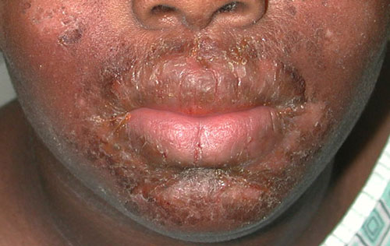
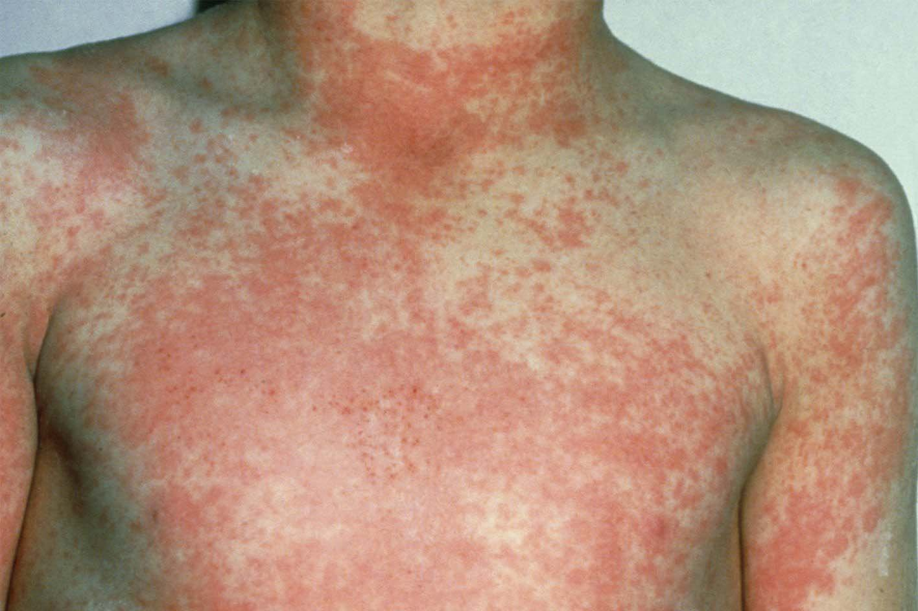
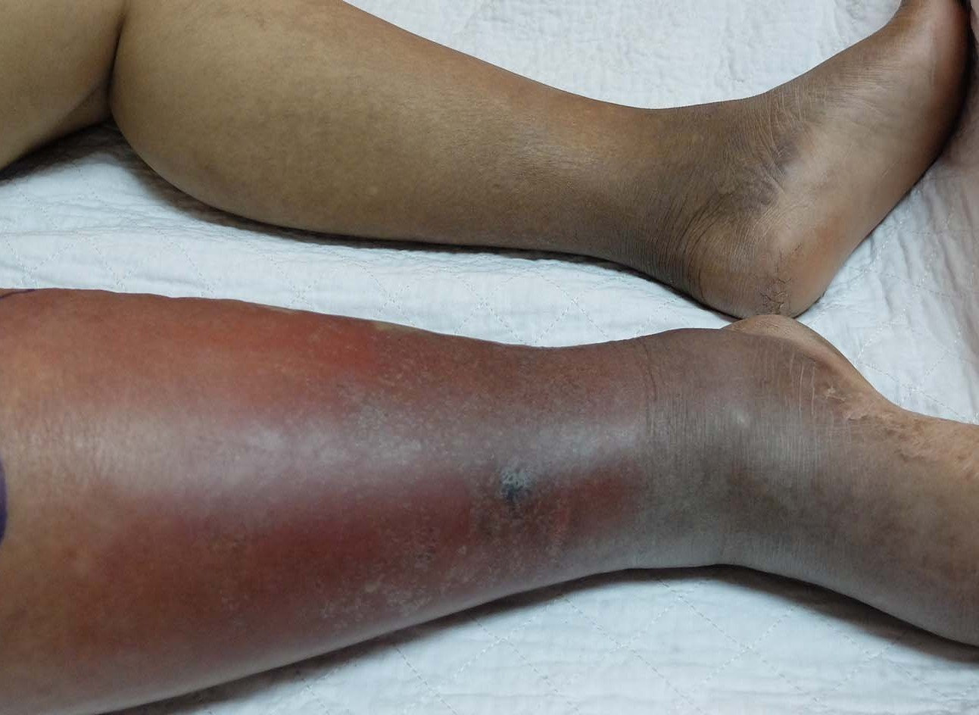
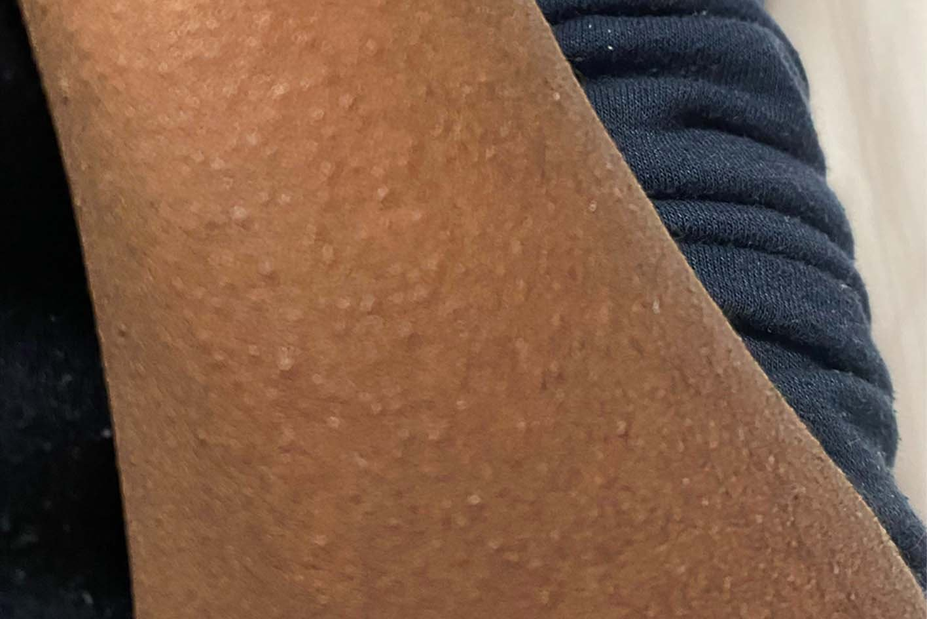
Scarlet Fever
Scarlet fever is caused by the Group A streptococcus (GAS) bacteria which also causes other infections like:
Impetigo
Cellulitis
‘Strep’ throat
Impetigo
Scarlet fever
Cellulitis
Scarlet fever
Notes:
Presenter Notes
Scarlet fever.
This is caused by the Group A streptococcus bacteria (also known GAS) which also causes other infections like:
Impetigo
Cellulitis
‘Strep’ throat
And so on

Slide 6
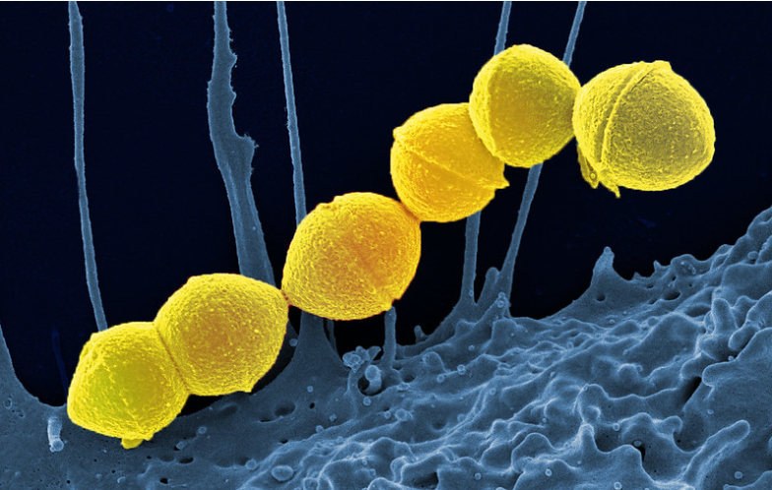
Group A Streptococcus (GAS)
Group A Strep - What you need to know - UK Health Security Agency (blog.gov.uk)
1 in 100 people carry on skin/ throat with no symptoms
Can be treated with antibiotics if causing illness
Notes:
Presenter Notes
Group A streptococcus (GAS), also referred to as Strep A is a common bacterium. Lots of us carry it in our throats and on our skin and it doesn’t always result in illness.
However, GAS causes a number of infections; some mild and some more serious.

Slide 7
Scarlet Fever and Chicken pox together
Children who have had chickenpox recently are more likely to develop more serious infection during an outbreak of scarlet fever and so parents should remain vigilant
Individuals should be excluded from setting until at least 24 hours after starting antibiotics. Individuals who do not take antibiotic treatment will be infectious for two to three weeks.
Be extra vigilant if there are 2 or more scarlet fever AND 2 or more chicken pox cases in the same group of children (e.g. class)
Notes:
Presenter Notes
Children who have had chickenpox recently are more likely to develop more serious infection during an outbreak of scarlet fever and so parents should remain vigilant
Individuals should be excluded from setting until at least 24 hours after starting antibiotics. Individuals who do not take antibiotic treatment will be infectious for two to three weeks.
Be extra vigilant if there are 2 or more scarlet fever AND 2 or more chicken pox cases in the same group of children (e.g. class)

Slide 8
When to call for support- GAS & Chickenpox/ARIs
If anyone is admitted to hospital (or there is a death) due to GAS
If you are a setting that is dedicated to children who are clinically vulnerable
If you have chicken pox AND GAS circulating in the same class or year group at the same time
If you think you have cases of confirmed flu AND scarlet fever / GAS in the SAME CLASS (not just the same year group).
If you are still getting SIGNIFICANT numbers of new cases after 3 weeks despite implementing all of the recommendations advised and you are still concerned about the situation
If you have further issues that are stopping, you applying the steps mentioned
Notes:
Presenter Notes
When to contact your local health team for support:
If anyone is admitted to hospital (or there is a death) due to GAS
If you are a setting that is dedicated to children who are clinically vulnerable
If you have chicken pox AND GAS circulating in the same class or year group at the same time
If you are still getting SIGNIFICANT numbers of new cases after 3 weeks despite implementing all of the recommendations advised and you are still concerned about the situation
If you have further issues that are stopping you applying the steps mentioned

Slide 9
Tummy bugs (Gastrointestinal infections)
Tummy bugs (GI) include food poisoning, gastroenteritis and norovirus. These infections spread when the germs enter the gut via the mouth.
Facts about Norovirus:
Symptoms start suddenly and include feeling sick, tummy aches, diarrhoea and/or vomiting
People will be ill from about 12 hours to 3 days.
You will often find a pattern of cases happening over a few days.
Children and employees can become ill with norovirus.
A high temperature is not usually a symptom
Notes:
Presenter Notes
Tummy Bugs are also known as Gastrointestinal infections. They include food poisoning, gastroenteritis and norovirus. They occur when germs enter the gut via the mouth.
For norovirus:
Symptoms start suddenly and include feeling sick, tummy aches, diarrhoea and/or vomiting
People will be ill from about 12 hours to 3 days. You can start to feel ill from 24-48 hours after being in contact with the virus.
You will often find a pattern of cases happening over a few days.
Children and employees can become ill with norovirus.
A high temperature is not usually a symptom

Slide 10
Managing cases and outbreaks of GI
Make sure all children and employees that are ill stay away until they have been better for 2 days (48 hours)
Clean up any sick or poo straight away using a household detergent and single use cloth. Then disinfect with a hypochlorite solution (e.g. Milton).
Tell parents and visitors about the cases of illness
Promote and reinforce hand hygiene with all employees
Cleaning (toilets, frequent touch points, mats etc)! Don’t hoover....
Until you are free of illness, we recommend you stop messy play, and don’t go on any visits out of your setting
After 48hrs with no cases, do a full clean of the building and all surfaces.
Notes:
Presenter Notes
How to manage cases and outbreak of Gastrointestinal infections/Tummy bugs
Make sure all children and employees that are ill go home and stay away until they have been better for at least 2 days (48 hours)
Clean up any sick or poo straight away using a household detergent and single use cloth. Then disinfect the area with a hypochlorite solution (e.g. Milton).
Tell parents and visitors about the cases of illness
All employees should make sure they are washing their hands regularly with soap and water.
Ensure proper cleaning especially in toilets, frequent touch points, mats etc)! Don’t just hoover....
Until you are free of illness, we recommend you stop messy play, remove soft toys that are tricky to clean, and don’t go on any visits out of your setting
After 48hrs with no cases, do a full clean of the building and all surfaces etc

Slide 11
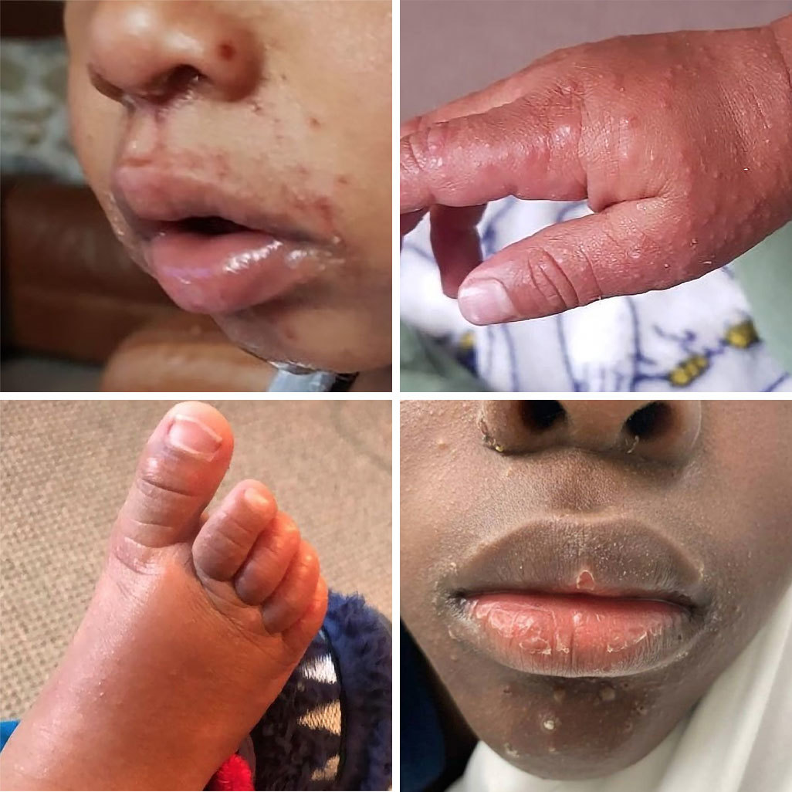
Hand, Foot and Mouth (HFM)
HFM mainly occurs in children under ten years of age, but adult cases are not unusual.
It is spread by direct contact with nasal and throat secretions or faeces of the infected person
Exclusion is not required
Pregnancy
It is advised that pregnant women should avoid close contact with a child who has hand, foot and mouth disease. Pregnant women who develop any symptoms of rashes during pregnancy should seek advice from their general practitioner or midwife.
Managing specific infectious diseases: A to Z - GOV.UK (www.gov.uk)
Hand, foot and mouth disease - NHS (www.nhs.uk)
Notes:
Presenter Notes
Hand, foot and mouth mainly occurs in children under ten years of age, but adult cases are not unusual.
It is spread by direct contact with nasal and throat secretions or faeces of the infected person
In cases of Hand, foot and mouth, Exclusion is not required
Pregnancy
Although there's usually no risk to the pregnancy or baby, it's best to avoid close contact with anyone who has hand, foot and mouth disease. Pregnant women who develop any symptoms of rashes during pregnancy should seek advice from their general practitioner or midwife.
There are links on the slide for more information on Hand, Foot and Mouth Disease from gov.uk and NHS websites

